Slide 1
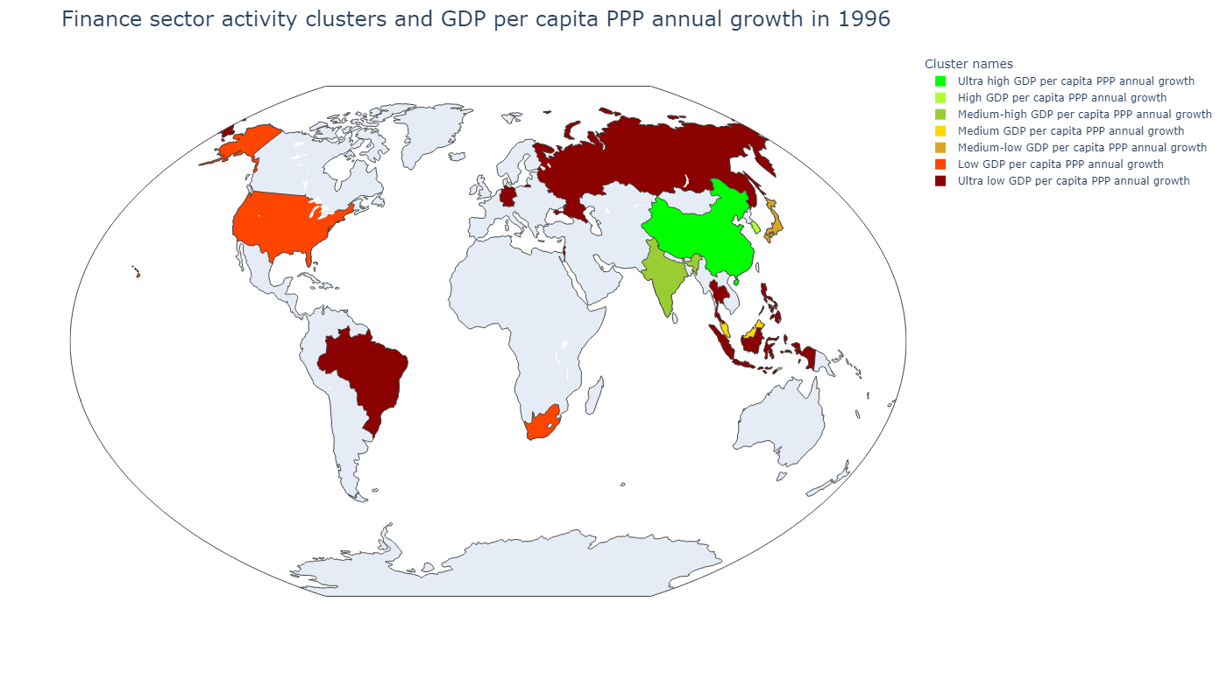
Country | Сluster names
Hong Kong SAR, China | Medium GDP per capita PPP annual growth
Israel | Ultra low GDP per capita PPP annual growth
Singapore | Low GDP per capita PPP annual growth
Sum of squared distances to their centroid: | 45 955,75
Сluster names | GDP per capita, PPP (weighted annual growth rate %) | Stock price volatility | Value-traded ratio (%) | Stock market turnover ratio (%) | Market capitalization to GDP | Bank deposits to GDP (%) | Broad money (% of GDP) | Central bank assets to GDP (%) | Domestic credit to private sector (% of GDP)
Ultra high GDP per capita PPP annual growth | 8,78 | 45,43 | 35,63 | 269,95 | 13,20 | 26,13 | 105,96 | 3,12 | 89,46
High GDP per capita PPP annual growth | 6,25 | 34,25 | 24,53 | 123,56 | 19,75 | 33,71 | 36,46 | 2,92 | 37,35
Medium-high GDP per capita PPP annual growth | 5,47 | 18,22 | 1 419,65 | 4 534,76 | 31,31 | 35,08 | 44,69 | 9,75 | 23,40
Medium GDP per capita PPP annual growth | 4,15 | 18,00 | 64,76 | 22,69 | 292,41 | 134,14 | 144,98 | 24,67 | 149,15
Medium-low GDP per capita PPP annual growth | 2,90 | 15,81 | 24,15 | 39,38 | 61,33 | 192,28 | 201,45 | 5,84 | 193,50
Low GDP per capita PPP annual growth | 2,59 | 11,97 | 55,06 | 44,44 | 136,29 | 58,14 | 63,06 | 29,10 | 112,32
Ultra low GDP per capita PPP annual growth | 1,34 | 22,14 | 10,29 | 25,30 | 38,70 | 48,23 | 52,71 | 3,89 | 65,35

Slide 2
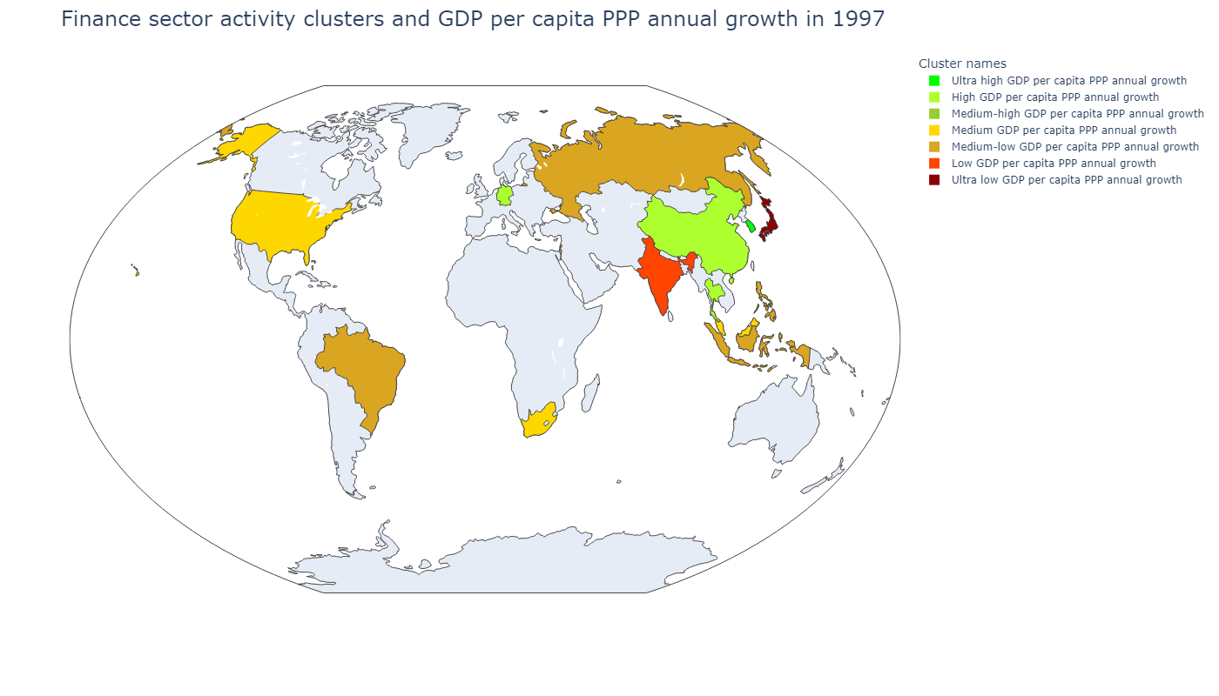
Country | Сluster names
Hong Kong SAR, China | Medium-high GDP per capita PPP annual growth
Israel | Medium-low GDP per capita PPP annual growth
Singapore | Medium GDP per capita PPP annual growth
Sum of squared distances to their centroid: | 45 217,89
Сluster names | GDP per capita, PPP (weighted annual growth rate %) | Stock price volatility | Value-traded ratio (%) | Stock market turnover ratio (%) | Market capitalization to GDP | Bank deposits to GDP (%) | Broad money (% of GDP) | Central bank assets to GDP (%) | Domestic credit to private sector (% of GDP)
Ultra high GDP per capita PPP annual growth | 5,18 | 24,91 | 29,98 | 407,88 | 7,35 | 34,65 | 37,55 | 1,46 | 56,67
High GDP per capita PPP annual growth | 2,76 | 26,80 | 15,57 | 55,77 | 29,74 | 41,36 | 45,94 | 4,86 | 41,71
Medium-high GDP per capita PPP annual growth | 4,23 | 20,60 | 255,44 | 109,61 | 233,05 | 160,26 | 166,11 | 46,37 | 169,28
Medium GDP per capita PPP annual growth | 0,74 | 15,18 | 23,20 | 49,98 | 46,42 | 200,32 | 210,02 | 6,05 | 206,58
Medium-low GDP per capita PPP annual growth | 3,19 | 14,88 | 62,39 | 55,25 | 114,81 | 72,35 | 79,76 | 23,37 | 125,95
Low GDP per capita PPP annual growth | 4,63 | 27,69 | 31,67 | 125,67 | 24,66 | 61,26 | 91,76 | 1,55 | 123,59
Сluster names | GDP per capita, PPP (weighted annual growth rate %) | Stock price volatility | Value-traded ratio (%) | Stock market turnover ratio (%) | Market capitalization to GDP | Bank deposits to GDP (%) | Broad money (% of GDP) | Central bank assets to GDP (%) | Domestic credit to private sector (% of GDP)
Ultra high GDP per capita PPP annual growth | 5,18 | 24,91 | 29,98 | 407,88 | 7,35 | 34,65 | 37,55 | 1,46 | 56,67
High GDP per capita PPP annual growth | 4,63 | 27,69 | 31,67 | 125,67 | 24,66 | 61,26 | 91,76 | 1,55 | 123,59
Medium-high GDP per capita PPP annual growth | 4,23 | 20,60 | 255,44 | 109,61 | 233,05 | 160,26 | 166,11 | 46,37 | 169,28
Medium GDP per capita PPP annual growth | 3,19 | 14,88 | 62,39 | 55,25 | 114,81 | 72,35 | 79,76 | 23,37 | 125,95
Medium-low GDP per capita PPP annual growth | 2,76 | 26,80 | 15,57 | 55,77 | 29,74 | 41,36 | 45,94 | 4,86 | 41,71
Low GDP per capita PPP annual growth | 2,07 | 24,83 | 164,83 | 535,53 | 30,78 | 37,84 | 47,46 | 8,89 | 23,56
Ultra low GDP per capita PPP annual growth | 0,74 | 15,18 | 23,20 | 49,98 | 46,42 | 200,32 | 210,02 | 6,05 | 206,58

Slide 3
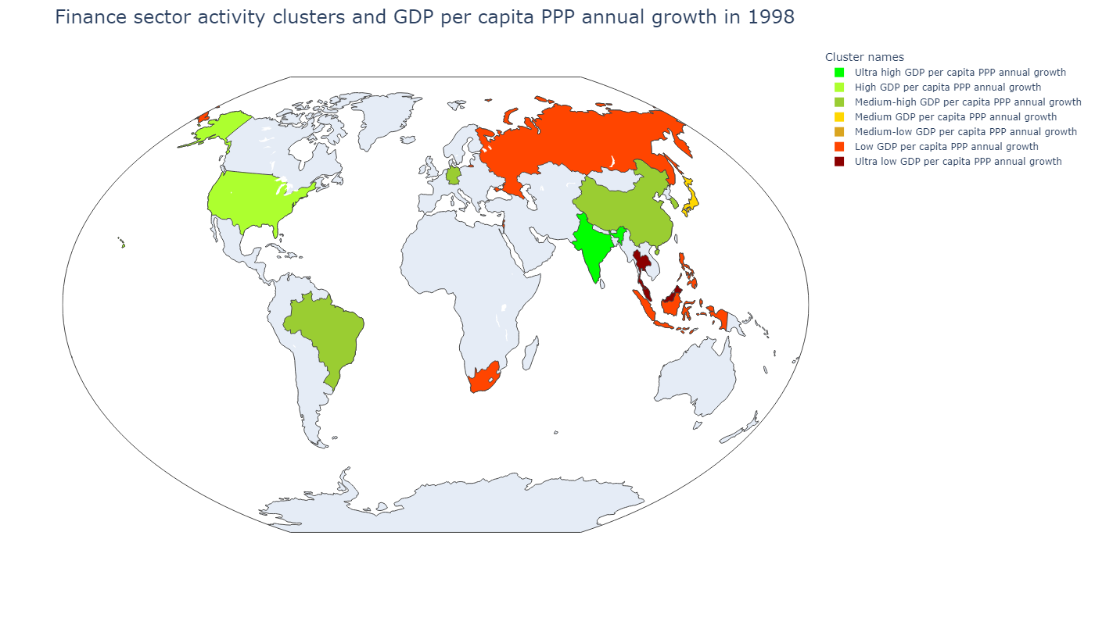
Country | Сluster names
Hong Kong SAR, China | Medium-low GDP per capita PPP annual growth
Israel | Low GDP per capita PPP annual growth
Singapore | Ultra low GDP per capita PPP annual growth
Sum of squared distances to their centroid: | 48 810,06
Сluster names | GDP per capita, PPP (weighted annual growth rate %) | Stock price volatility | Value-traded ratio (%) | Stock market turnover ratio (%) | Market capitalization to GDP | Bank deposits to GDP (%) | Broad money (% of GDP) | Central bank assets to GDP (%) | Domestic credit to private sector (% of GDP)
Ultra high GDP per capita PPP annual growth | 3,27 | 18,30 | 135,78 | 95,22 | 142,59 | 60,49 | 65,46 | 4,99 | 157,80
High GDP per capita PPP annual growth | - 1,54 | 21,77 | 25,51 | 42,86 | 59,52 | 209,33 | 219,45 | 12,66 | 214,58
Medium-high GDP per capita PPP annual growth | - 7,41 | 31,02 | 15,63 | 40,11 | 44,47 | 47,52 | 52,86 | 5,39 | 56,22
Medium GDP per capita PPP annual growth | - 8,46 | 40,08 | 41,66 | 51,86 | 91,12 | 107,53 | 115,78 | 33,09 | 139,95
Medium-low GDP per capita PPP annual growth | 4,20 | 23,48 | 155,37 | 623,47 | 24,92 | 39,51 | 48,90 | 8,87 | 23,68
Low GDP per capita PPP annual growth | 2,51 | 35,65 | 35,16 | 134,91 | 26,41 | 40,60 | 60,61 | 4,11 | 65,32
Сluster names | GDP per capita, PPP (weighted annual growth rate %) | Stock price volatility | Value-traded ratio (%) | Stock market turnover ratio (%) | Market capitalization to GDP | Bank deposits to GDP (%) | Broad money (% of GDP) | Central bank assets to GDP (%) | Domestic credit to private sector (% of GDP)
Ultra high GDP per capita PPP annual growth | 4,20 | 23,48 | 155,37 | 623,47 | 24,92 | 39,51 | 48,90 | 8,87 | 23,68
High GDP per capita PPP annual growth | 3,27 | 18,30 | 135,78 | 95,22 | 142,59 | 60,49 | 65,46 | 4,99 | 157,80
Medium-high GDP per capita PPP annual growth | 2,51 | 35,65 | 35,16 | 134,91 | 26,41 | 40,60 | 60,61 | 4,11 | 65,32
Medium GDP per capita PPP annual growth | - 1,54 | 21,77 | 25,51 | 42,86 | 59,52 | 209,33 | 219,45 | 12,66 | 214,58
Medium-low GDP per capita PPP annual growth | - 6,67 | 43,54 | 121,94 | 59,94 | 203,43 | 187,58 | 193,77 | 69,98 | 166,80
Low GDP per capita PPP annual growth | - 7,41 | 31,02 | 15,63 | 40,11 | 44,47 | 47,52 | 52,86 | 5,39 | 56,22
Ultra low GDP per capita PPP annual growth | - 8,46 | 40,08 | 41,66 | 51,86 | 91,12 | 107,53 | 115,78 | 33,09 | 139,95

Slide 4
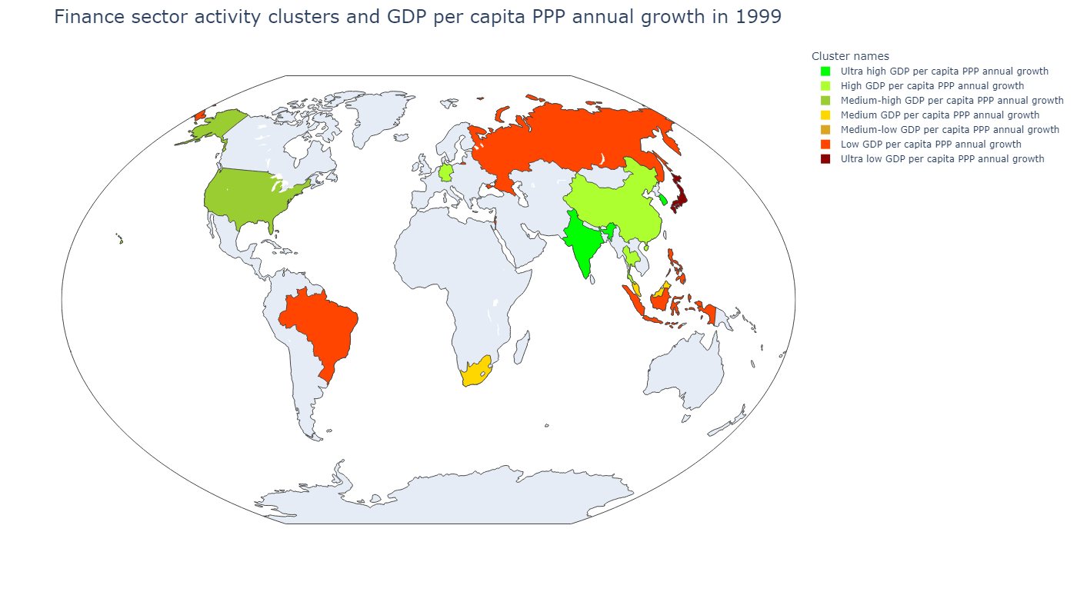
Country | Сluster names
Hong Kong SAR, China | Medium-low GDP per capita PPP annual growth
Israel | Low GDP per capita PPP annual growth
Singapore | Medium GDP per capita PPP annual growth
Sum of squared distances to their centroid: | 49 292,33
Сluster names | GDP per capita, PPP (weighted annual growth rate %) | Stock price volatility | Value-traded ratio (%) | Stock market turnover ratio (%) | Market capitalization to GDP | Bank deposits to GDP (%) | Broad money (% of GDP) | Central bank assets to GDP (%) | Domestic credit to private sector (% of GDP)
Ultra high GDP per capita PPP annual growth | 7,90 | 17,84 | 111,37 | 210,51 | 50,93 | 46,82 | 53,37 | 4,84 | 46,13
High GDP per capita PPP annual growth | 1,53 | 40,44 | 137,34 | 37,44 | 366,87 | 205,75 | 213,47 | 77,00 | 152,79
Medium-high GDP per capita PPP annual growth | 3,59 | 20,90 | 195,36 | 127,33 | 153,43 | 61,84 | 67,45 | 4,96 | 171,61
Medium GDP per capita PPP annual growth | - 0,52 | 22,12 | 43,76 | 45,53 | 96,10 | 217,95 | 229,20 | 11,93 | 217,76
Medium-low GDP per capita PPP annual growth | 0,37 | 42,78 | 18,34 | 41,07 | 44,63 | 44,60 | 49,68 | 9,61 | 31,08
Low GDP per capita PPP annual growth | 4,70 | 31,44 | 45,49 | 104,42 | 46,88 | 72,12 | 104,13 | 2,05 | 116,98
Сluster names | GDP per capita, PPP (weighted annual growth rate %) | Stock price volatility | Value-traded ratio (%) | Stock market turnover ratio (%) | Market capitalization to GDP | Bank deposits to GDP (%) | Broad money (% of GDP) | Central bank assets to GDP (%) | Domestic credit to private sector (% of GDP)
Ultra high GDP per capita PPP annual growth | 7,90 | 17,84 | 111,37 | 210,51 | 50,93 | 46,82 | 53,37 | 4,84 | 46,13
High GDP per capita PPP annual growth | 4,70 | 31,44 | 45,49 | 104,42 | 46,88 | 72,12 | 104,13 | 2,05 | 116,98
Medium-high GDP per capita PPP annual growth | 3,59 | 20,90 | 195,36 | 127,33 | 153,43 | 61,84 | 67,45 | 4,96 | 171,61
Medium GDP per capita PPP annual growth | 2,76 | 36,54 | 75,22 | 37,92 | 190,62 | 93,83 | 100,56 | 33,09 | 123,34
Medium-low GDP per capita PPP annual growth | 1,53 | 40,44 | 137,34 | 37,44 | 366,87 | 205,75 | 213,47 | 77,00 | 152,79
Low GDP per capita PPP annual growth | 0,37 | 42,78 | 18,34 | 41,07 | 44,63 | 44,60 | 49,68 | 9,61 | 31,08
Ultra low GDP per capita PPP annual growth | - 0,52 | 22,12 | 43,76 | 45,53 | 96,10 | 217,95 | 229,20 | 11,93 | 217,76

Slide 5
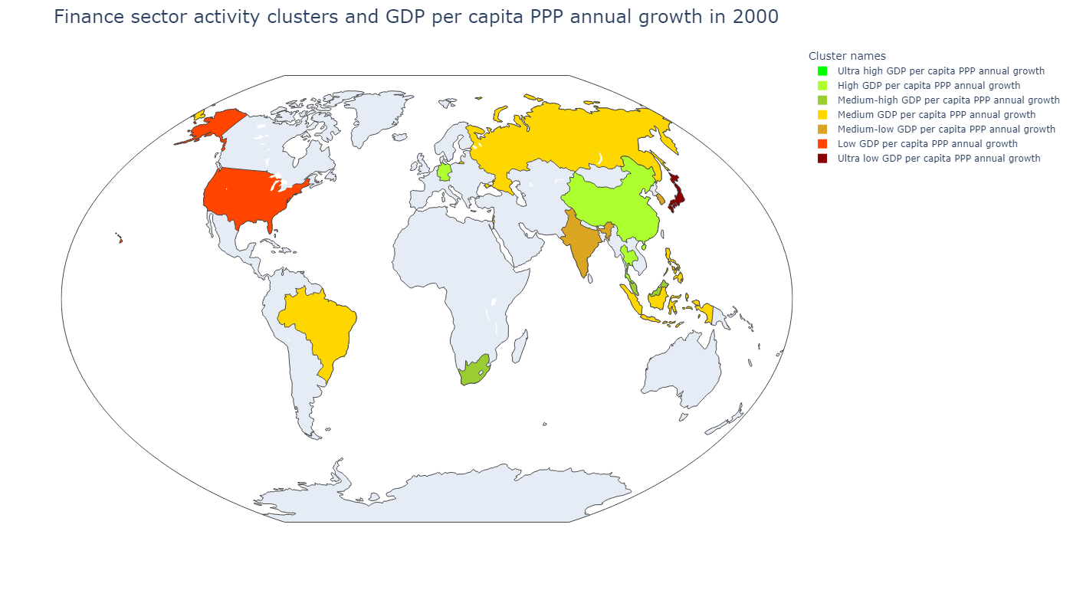
Country | Сluster names
Hong Kong SAR, China | Ultra high GDP per capita PPP annual growth
Israel | Medium GDP per capita PPP annual growth
Singapore | Medium-high GDP per capita PPP annual growth
Sum of squared distances to their centroid: | 40 625,92
Сluster names | GDP per capita, PPP (weighted annual growth rate %) | Stock price volatility | Value-traded ratio (%) | Stock market turnover ratio (%) | Market capitalization to GDP | Bank deposits to GDP (%) | Broad money (% of GDP) | Central bank assets to GDP (%) | Domestic credit to private sector (% of GDP)
Ultra high GDP per capita PPP annual growth | 5,63 | 28,62 | 57,07 | 113,18 | 45,43 | 77,59 | 103,76 | 1,53 | 110,65
High GDP per capita PPP annual growth | 2,59 | 21,64 | 49,94 | 78,58 | 63,55 | 217,51 | 229,08 | 10,12 | 208,82
Medium-high GDP per capita PPP annual growth | 2,93 | 20,44 | 290,53 | 197,13 | 147,38 | 63,16 | 68,51 | 4,99 | 162,62
Medium GDP per capita PPP annual growth | 6,72 | 30,30 | 217,28 | 59,83 | 363,14 | 217,54 | 224,39 | 80,41 | 150,35
Medium-low GDP per capita PPP annual growth | 5,01 | 31,51 | 11,24 | 37,72 | 29,17 | 45,64 | 51,36 | 8,48 | 34,16
Low GDP per capita PPP annual growth | 5,04 | 24,00 | 67,16 | 47,73 | 138,11 | 84,77 | 91,08 | 32,50 | 116,05
Сluster names | GDP per capita, PPP (weighted annual growth rate %) | Stock price volatility | Value-traded ratio (%) | Stock market turnover ratio (%) | Market capitalization to GDP | Bank deposits to GDP (%) | Broad money (% of GDP) | Central bank assets to GDP (%) | Domestic credit to private sector (% of GDP)
Ultra high GDP per capita PPP annual growth | 6,72 | 30,30 | 217,28 | 59,83 | 363,14 | 217,54 | 224,39 | 80,41 | 150,35
High GDP per capita PPP annual growth | 5,63 | 28,62 | 57,07 | 113,18 | 45,43 | 77,59 | 103,76 | 1,53 | 110,65
Medium-high GDP per capita PPP annual growth | 5,04 | 24,00 | 67,16 | 47,73 | 138,11 | 84,77 | 91,08 | 32,50 | 116,05
Medium GDP per capita PPP annual growth | 5,01 | 31,51 | 11,24 | 37,72 | 29,17 | 45,64 | 51,36 | 8,48 | 34,16
Medium-low GDP per capita PPP annual growth | 3,99 | 33,42 | 85,32 | 251,53 | 34,44 | 45,76 | 50,52 | 3,07 | 39,14
Low GDP per capita PPP annual growth | 2,93 | 20,44 | 290,53 | 197,13 | 147,38 | 63,16 | 68,51 | 4,99 | 162,62
Ultra low GDP per capita PPP annual growth | 2,59 | 21,64 | 49,94 | 78,58 | 63,55 | 217,51 | 229,08 | 10,12 | 208,82

Slide 6
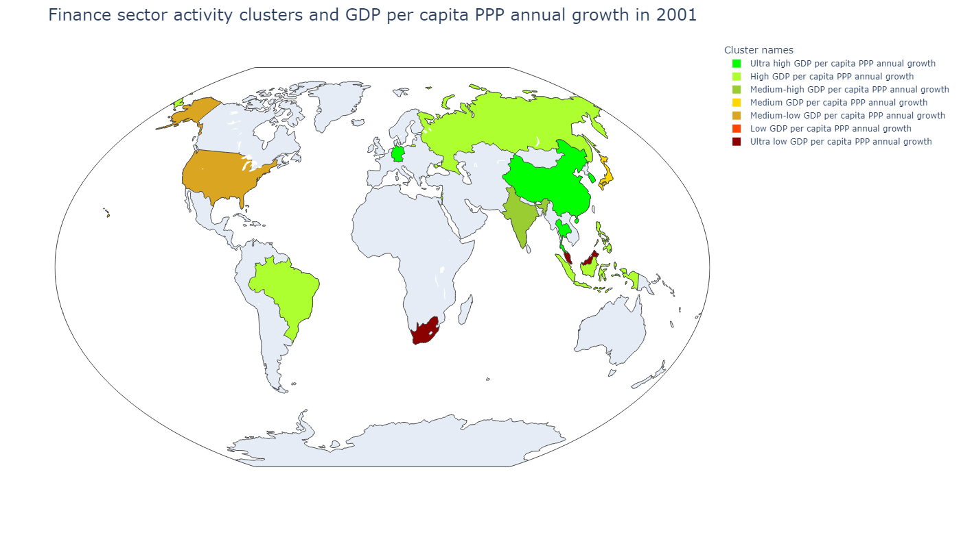
Country | Сluster names
Hong Kong SAR, China | Low GDP per capita PPP annual growth
Israel | High GDP per capita PPP annual growth
Singapore | Ultra low GDP per capita PPP annual growth
Sum of squared distances to their centroid: | 35 577,81
Сluster names | GDP per capita, PPP (weighted annual growth rate %) | Stock price volatility | Value-traded ratio (%) | Stock market turnover ratio (%) | Market capitalization to GDP | Bank deposits to GDP (%) | Broad money (% of GDP) | Central bank assets to GDP (%) | Domestic credit to private sector (% of GDP)
Ultra high GDP per capita PPP annual growth | 0,14 | 22,29 | 38,90 | 75,16 | 51,76 | 178,15 | 190,93 | 14,73 | 180,20
High GDP per capita PPP annual growth | 0,92 | 44,94 | 41,84 | 151,27 | 27,32 | 44,63 | 51,01 | 10,37 | 21,82
Medium-high GDP per capita PPP annual growth | - 0,64 | 21,39 | 42,65 | 34,37 | 121,99 | 92,94 | 100,78 | 32,96 | 121,73
Medium GDP per capita PPP annual growth | - 0,04 | 22,08 | 197,35 | 149,34 | 132,15 | 65,73 | 71,64 | 5,21 | 170,85
Medium-low GDP per capita PPP annual growth | 1,97 | 28,66 | 8,33 | 30,74 | 28,44 | 46,95 | 54,81 | 9,02 | 35,38
Low GDP per capita PPP annual growth | 5,02 | 22,53 | 48,88 | 114,00 | 41,70 | 66,67 | 108,78 | 1,75 | 104,69
Сluster names | GDP per capita, PPP (weighted annual growth rate %) | Stock price volatility | Value-traded ratio (%) | Stock market turnover ratio (%) | Market capitalization to GDP | Bank deposits to GDP (%) | Broad money (% of GDP) | Central bank assets to GDP (%) | Domestic credit to private sector (% of GDP)
Ultra high GDP per capita PPP annual growth | 5,02 | 22,53 | 48,88 | 114,00 | 41,70 | 66,67 | 108,78 | 1,75 | 104,69
High GDP per capita PPP annual growth | 1,97 | 28,66 | 8,33 | 30,74 | 28,44 | 46,95 | 54,81 | 9,02 | 35,38
Medium-high GDP per capita PPP annual growth | 0,92 | 44,94 | 41,84 | 151,27 | 27,32 | 44,63 | 51,01 | 10,37 | 21,82
Medium GDP per capita PPP annual growth | 0,14 | 22,29 | 38,90 | 75,16 | 51,76 | 178,15 | 190,93 | 14,73 | 180,20
Medium-low GDP per capita PPP annual growth | - 0,04 | 22,08 | 197,35 | 149,34 | 132,15 | 65,73 | 71,64 | 5,21 | 170,85
Low GDP per capita PPP annual growth | - 0,18 | 29,25 | 140,61 | 47,07 | 298,74 | 218,86 | 226,53 | 75,05 | 148,98
Ultra low GDP per capita PPP annual growth | - 0,64 | 21,39 | 42,65 | 34,37 | 121,99 | 92,94 | 100,78 | 32,96 | 121,73

Slide 7
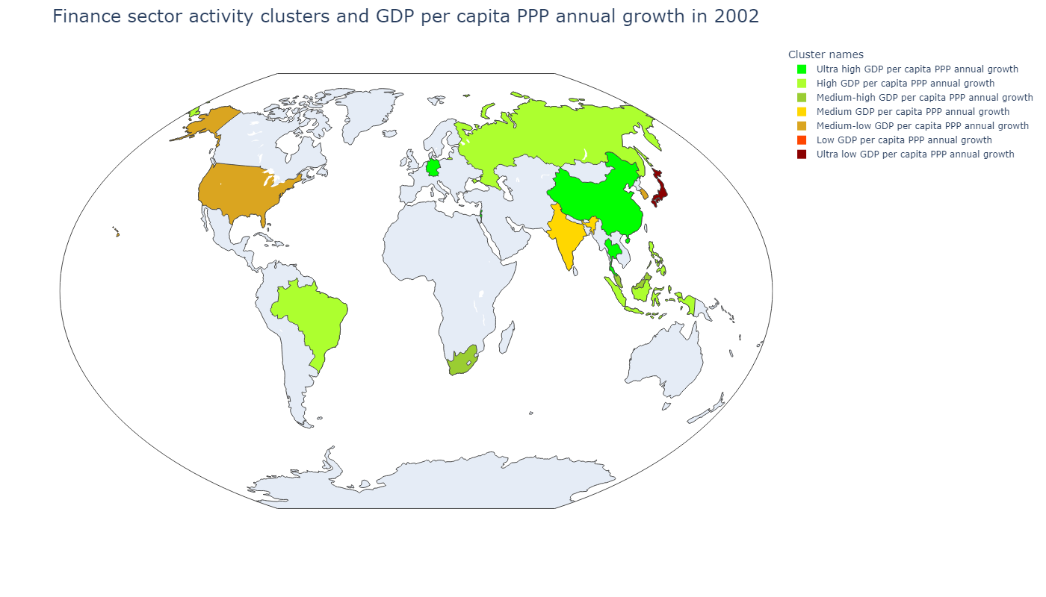
Country | Сluster names
Hong Kong SAR, China | Low GDP per capita PPP annual growth
Israel | Ultra high GDP per capita PPP annual growth
Singapore | Medium-high GDP per capita PPP annual growth
Sum of squared distances to their centroid: | 43 480,76
Сluster names | GDP per capita, PPP (weighted annual growth rate %) | Stock price volatility | Value-traded ratio (%) | Stock market turnover ratio (%) | Market capitalization to GDP | Bank deposits to GDP (%) | Broad money (% of GDP) | Central bank assets to GDP (%) | Domestic credit to private sector (% of GDP)
Ultra high GDP per capita PPP annual growth | 8,78 | 45,43 | 35,63 | 269,95 | 13,20 | 26,13 | 105,96 | 3,12 | 89,46
High GDP per capita PPP annual growth | 6,25 | 34,25 | 24,53 | 123,56 | 19,75 | 33,71 | 36,46 | 2,92 | 37,35
Medium-high GDP per capita PPP annual growth | 5,47 | 18,22 | 1 419,65 | 4 534,76 | 31,31 | 35,08 | 44,69 | 9,75 | 23,40
Medium GDP per capita PPP annual growth | 4,15 | 18,00 | 64,76 | 22,69 | 292,41 | 134,14 | 144,98 | 24,67 | 149,15
Medium-low GDP per capita PPP annual growth | 2,90 | 15,81 | 24,15 | 39,38 | 61,33 | 192,28 | 201,45 | 5,84 | 193,50
Low GDP per capita PPP annual growth | 2,59 | 11,97 | 55,06 | 44,44 | 136,29 | 58,14 | 63,06 | 29,10 | 112,32
Сluster names | GDP per capita, PPP (weighted annual growth rate %) | Stock price volatility | Value-traded ratio (%) | Stock market turnover ratio (%) | Market capitalization to GDP | Bank deposits to GDP (%) | Broad money (% of GDP) | Central bank assets to GDP (%) | Domestic credit to private sector (% of GDP)
Ultra high GDP per capita PPP annual growth | 5,18 | 24,96 | 26,19 | 79,46 | 33,02 | 71,78 | 103,86 | 1,73 | 100,78
High GDP per capita PPP annual growth | 3,02 | 26,29 | 7,60 | 30,57 | 24,52 | 38,38 | 46,75 | 11,93 | 25,64
Medium-high GDP per capita PPP annual growth | 2,81 | 20,54 | 43,53 | 36,26 | 125,13 | 88,35 | 98,01 | 36,92 | 107,06
Medium GDP per capita PPP annual growth | 2,57 | 41,45 | 33,27 | 151,47 | 24,22 | 44,35 | 50,64 | 6,66 | 23,23
Medium-low GDP per capita PPP annual growth | 1,30 | 22,51 | 124,33 | 193,00 | 70,56 | 64,99 | 91,79 | 3,35 | 137,53
Low GDP per capita PPP annual growth | 1,21 | 25,86 | 107,57 | 38,64 | 278,36 | 223,25 | 231,96 | 75,21 | 145,71
Ultra low GDP per capita PPP annual growth | - 0,19 | 23,51 | 41,42 | 83,73 | 49,47 | 181,73 | 195,33 | 16,12 | 177,92

Slide 8
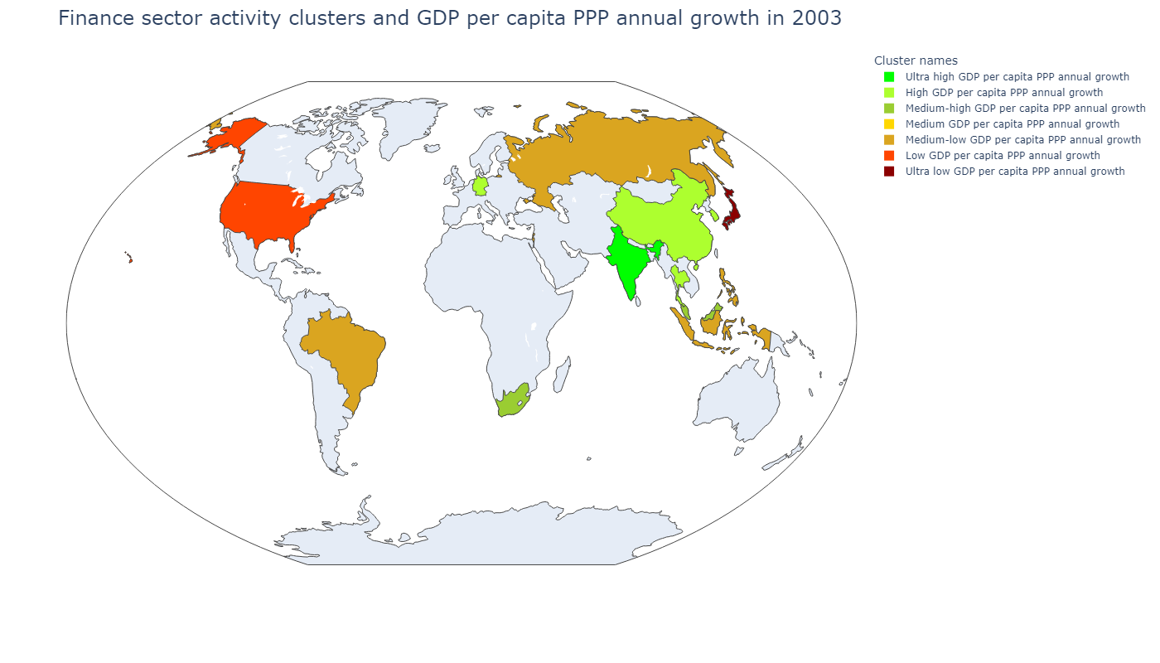
Country | Сluster names
Hong Kong SAR, China | Medium GDP per capita PPP annual growth
Israel | Medium-low GDP per capita PPP annual growth
Singapore | Medium-high GDP per capita PPP annual growth
Sum of squared distances to their centroid: | 40 470,13
Сluster names | GDP per capita, PPP (weighted annual growth rate %) | Stock price volatility | Value-traded ratio (%) | Stock market turnover ratio (%) | Market capitalization to GDP | Bank deposits to GDP (%) | Broad money (% of GDP) | Central bank assets to GDP (%) | Domestic credit to private sector (% of GDP)
Ultra high GDP per capita PPP annual growth | 8,78 | 45,43 | 35,63 | 269,95 | 13,20 | 26,13 | 105,96 | 3,12 | 89,46
High GDP per capita PPP annual growth | 6,25 | 34,25 | 24,53 | 123,56 | 19,75 | 33,71 | 36,46 | 2,92 | 37,35
Medium-high GDP per capita PPP annual growth | 5,47 | 18,22 | 1 419,65 | 4 534,76 | 31,31 | 35,08 | 44,69 | 9,75 | 23,40
Medium GDP per capita PPP annual growth | 4,15 | 18,00 | 64,76 | 22,69 | 292,41 | 134,14 | 144,98 | 24,67 | 149,15
Medium-low GDP per capita PPP annual growth | 2,90 | 15,81 | 24,15 | 39,38 | 61,33 | 192,28 | 201,45 | 5,84 | 193,50
Low GDP per capita PPP annual growth | 2,59 | 11,97 | 55,06 | 44,44 | 136,29 | 58,14 | 63,06 | 29,10 | 112,32
Сluster names | GDP per capita, PPP (weighted annual growth rate %) | Stock price volatility | Value-traded ratio (%) | Stock market turnover ratio (%) | Market capitalization to GDP | Bank deposits to GDP (%) | Broad money (% of GDP) | Central bank assets to GDP (%) | Domestic credit to private sector (% of GDP)
Ultra high GDP per capita PPP annual growth | 5,71 | 41,91 | 38,86 | 117,51 | 36,29 | 42,03 | 48,55 | 3,99 | 22,88
High GDP per capita PPP annual growth | 5,66 | 28,50 | 49,44 | 99,13 | 49,77 | 69,22 | 110,10 | 1,36 | 110,22
Medium-high GDP per capita PPP annual growth | 3,26 | 17,87 | 54,33 | 36,92 | 143,45 | 90,97 | 100,26 | 38,80 | 108,84
Medium GDP per capita PPP annual growth | 3,26 | 19,75 | 169,07 | 38,18 | 442,79 | 244,34 | 254,50 | 85,49 | 146,23
Medium-low GDP per capita PPP annual growth | 3,19 | 29,87 | 10,59 | 24,77 | 39,81 | 46,84 | 55,45 | 8,27 | 35,55
Low GDP per capita PPP annual growth | 1,92 | 24,68 | 140,05 | 112,47 | 124,53 | 66,04 | 72,16 | 5,82 | 177,40
Ultra low GDP per capita PPP annual growth | 1,32 | 21,74 | 51,51 | 78,83 | 65,34 | 182,64 | 196,57 | 17,88 | 177,54

Slide 9
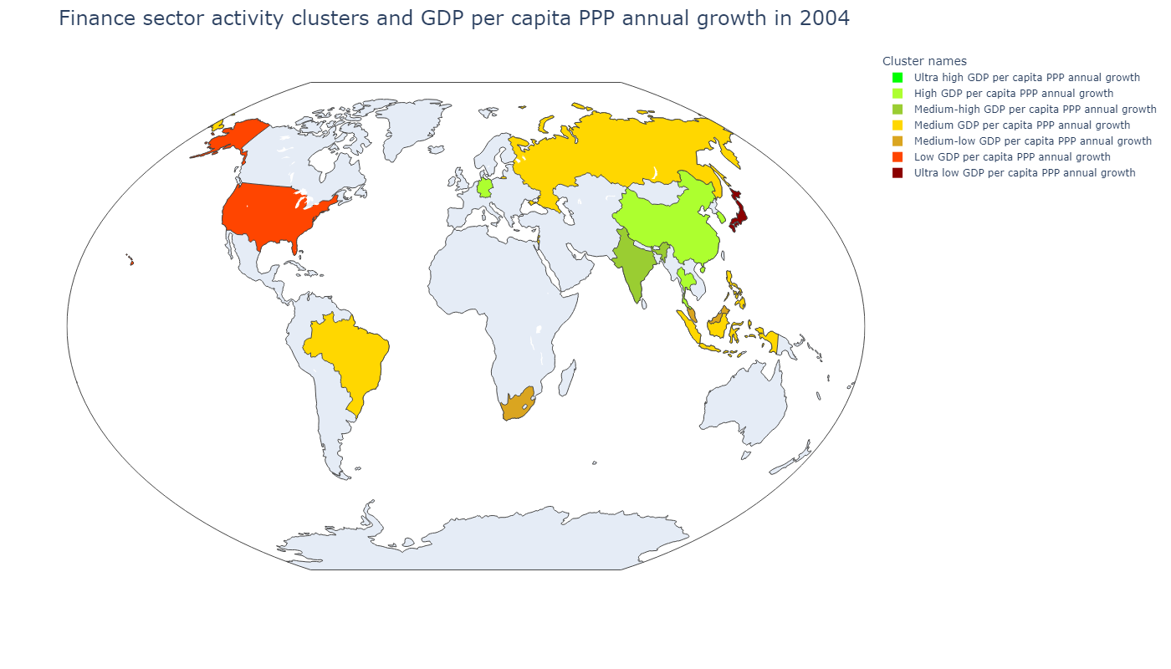
Country | Сluster names
Hong Kong SAR, China | Ultra high GDP per capita PPP annual growth
Israel | Medium GDP per capita PPP annual growth
Singapore | Medium-low GDP per capita PPP annual growth
Sum of squared distances to their centroid: | 37 349,84
Сluster names | GDP per capita, PPP (weighted annual growth rate %) | Stock price volatility | Value-traded ratio (%) | Stock market turnover ratio (%) | Market capitalization to GDP | Bank deposits to GDP (%) | Broad money (% of GDP) | Central bank assets to GDP (%) | Domestic credit to private sector (% of GDP)
Ultra high GDP per capita PPP annual growth | 8,78 | 45,43 | 35,63 | 269,95 | 13,20 | 26,13 | 105,96 | 3,12 | 89,46
High GDP per capita PPP annual growth | 6,25 | 34,25 | 24,53 | 123,56 | 19,75 | 33,71 | 36,46 | 2,92 | 37,35
Medium-high GDP per capita PPP annual growth | 5,47 | 18,22 | 1 419,65 | 4 534,76 | 31,31 | 35,08 | 44,69 | 9,75 | 23,40
Medium GDP per capita PPP annual growth | 4,15 | 18,00 | 64,76 | 22,69 | 292,41 | 134,14 | 144,98 | 24,67 | 149,15
Medium-low GDP per capita PPP annual growth | 2,90 | 15,81 | 24,15 | 39,38 | 61,33 | 192,28 | 201,45 | 5,84 | 193,50
Low GDP per capita PPP annual growth | 2,59 | 11,97 | 55,06 | 44,44 | 136,29 | 58,14 | 63,06 | 29,10 | 112,32
Сluster names | GDP per capita, PPP (weighted annual growth rate %) | Stock price volatility | Value-traded ratio (%) | Stock market turnover ratio (%) | Market capitalization to GDP | Bank deposits to GDP (%) | Broad money (% of GDP) | Central bank assets to GDP (%) | Domestic credit to private sector (% of GDP)
Ultra high GDP per capita PPP annual growth | 7,86 | 17,65 | 238,75 | 46,87 | 509,44 | 249,99 | 262,82 | 81,36 | 144,76
High GDP per capita PPP annual growth | 6,56 | 25,99 | 50,52 | 109,31 | 46,52 | 66,36 | 107,49 | 1,08 | 106,52
Medium-high GDP per capita PPP annual growth | 6,56 | 40,95 | 44,51 | 119,92 | 41,32 | 42,39 | 48,92 | 3,34 | 26,47
Medium GDP per capita PPP annual growth | 5,15 | 31,42 | 14,12 | 30,57 | 43,79 | 46,47 | 55,41 | 7,26 | 36,63
Medium-low GDP per capita PPP annual growth | 4,87 | 15,63 | 57,51 | 33,24 | 169,22 | 87,32 | 97,74 | 35,73 | 106,83
Low GDP per capita PPP annual growth | 2,89 | 15,37 | 156,36 | 117,03 | 133,61 | 65,40 | 71,55 | 5,88 | 184,81
Ultra low GDP per capita PPP annual growth | 2,15 | 19,81 | 70,66 | 97,19 | 72,71 | 181,86 | 195,77 | 18,30 | 170,77

Slide 10
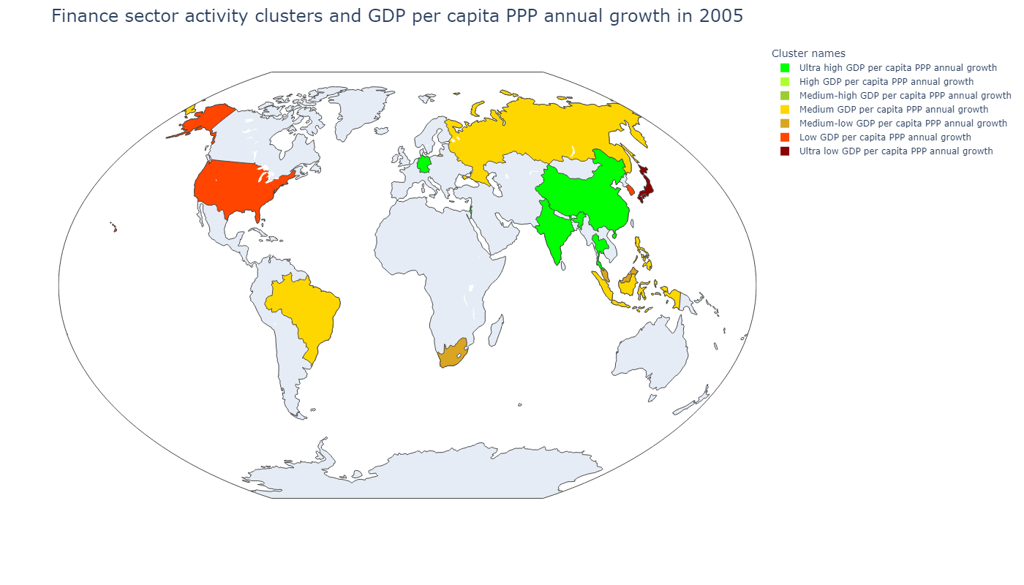
Country | Сluster names
Hong Kong SAR, China | High GDP per capita PPP annual growth
Israel | Ultra high GDP per capita PPP annual growth
Singapore | Medium-high GDP per capita PPP annual growth
Sum of squared distances to their centroid: | 42 631,98
Сluster names | GDP per capita, PPP (weighted annual growth rate %) | Stock price volatility | Value-traded ratio (%) | Stock market turnover ratio (%) | Market capitalization to GDP | Bank deposits to GDP (%) | Broad money (% of GDP) | Central bank assets to GDP (%) | Domestic credit to private sector (% of GDP)
Ultra high GDP per capita PPP annual growth | 8,78 | 45,43 | 35,63 | 269,95 | 13,20 | 26,13 | 105,96 | 3,12 | 89,46
High GDP per capita PPP annual growth | 6,25 | 34,25 | 24,53 | 123,56 | 19,75 | 33,71 | 36,46 | 2,92 | 37,35
Medium-high GDP per capita PPP annual growth | 5,47 | 18,22 | 1 419,65 | 4 534,76 | 31,31 | 35,08 | 44,69 | 9,75 | 23,40
Medium GDP per capita PPP annual growth | 4,15 | 18,00 | 64,76 | 22,69 | 292,41 | 134,14 | 144,98 | 24,67 | 149,15
Medium-low GDP per capita PPP annual growth | 2,90 | 15,81 | 24,15 | 39,38 | 61,33 | 192,28 | 201,45 | 5,84 | 193,50
Low GDP per capita PPP annual growth | 2,59 | 11,97 | 55,06 | 44,44 | 136,29 | 58,14 | 63,06 | 29,10 | 112,32
Сluster names | GDP per capita, PPP (weighted annual growth rate %) | Stock price volatility | Value-traded ratio (%) | Stock market turnover ratio (%) | Market capitalization to GDP | Bank deposits to GDP (%) | Broad money (% of GDP) | Central bank assets to GDP (%) | Domestic credit to private sector (% of GDP)
Ultra high GDP per capita PPP annual growth | 7,18 | 21,01 | 39,29 | 77,55 | 56,95 | 68,92 | 97,04 | 1,30 | 85,20
High GDP per capita PPP annual growth | 6,92 | 14,81 | 231,97 | 39,92 | 581,04 | 241,65 | 257,69 | 79,19 | 143,13
Medium-high GDP per capita PPP annual growth | 4,87 | 12,12 | 91,25 | 45,32 | 201,35 | 96,47 | 103,33 | 100,67 | 89,22
Medium GDP per capita PPP annual growth | 4,60 | 28,49 | 18,54 | 47,09 | 44,44 | 38,17 | 45,52 | 6,16 | 26,70
Medium-low GDP per capita PPP annual growth | 3,68 | 12,07 | 34,82 | 22,50 | 157,96 | 78,84 | 92,36 | 1,06 | 114,40
Low GDP per capita PPP annual growth | 2,67 | 18,61 | 163,07 | 159,40 | 103,59 | 61,69 | 89,57 | 3,23 | 149,47
Ultra low GDP per capita PPP annual growth | 1,79 | 15,62 | 89,78 | 94,86 | 94,65 | 181,21 | 195,05 | 18,80 | 168,90

Slide 11
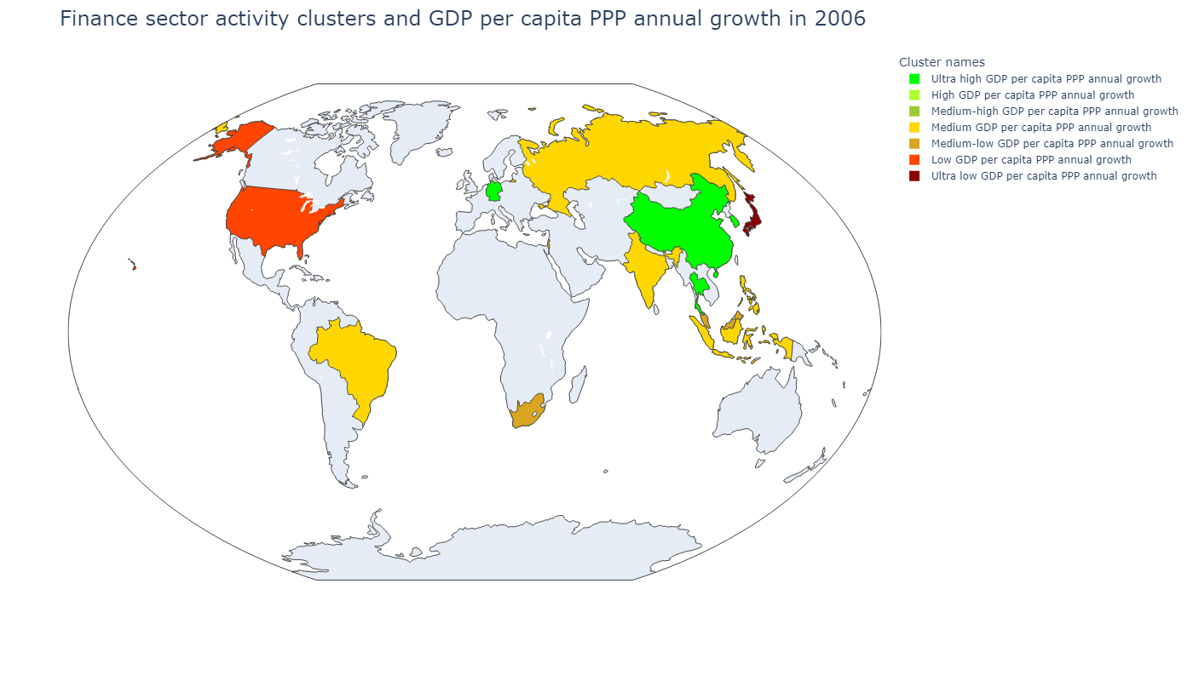
Country | Сluster names
Hong Kong SAR, China | High GDP per capita PPP annual growth
Israel | Medium GDP per capita PPP annual growth
Singapore | Medium-high GDP per capita PPP annual growth
Sum of squared distances to their centroid: | 50 323,09
Сluster names | GDP per capita, PPP (weighted annual growth rate %) | Stock price volatility | Value-traded ratio (%) | Stock market turnover ratio (%) | Market capitalization to GDP | Bank deposits to GDP (%) | Broad money (% of GDP) | Central bank assets to GDP (%) | Domestic credit to private sector (% of GDP)
Ultra high GDP per capita PPP annual growth | 8,78 | 45,43 | 35,63 | 269,95 | 13,20 | 26,13 | 105,96 | 3,12 | 89,46
High GDP per capita PPP annual growth | 6,25 | 34,25 | 24,53 | 123,56 | 19,75 | 33,71 | 36,46 | 2,92 | 37,35
Medium-high GDP per capita PPP annual growth | 5,47 | 18,22 | 1 419,65 | 4 534,76 | 31,31 | 35,08 | 44,69 | 9,75 | 23,40
Medium GDP per capita PPP annual growth | 4,15 | 18,00 | 64,76 | 22,69 | 292,41 | 134,14 | 144,98 | 24,67 | 149,15
Medium-low GDP per capita PPP annual growth | 2,90 | 15,81 | 24,15 | 39,38 | 61,33 | 192,28 | 201,45 | 5,84 | 193,50
Low GDP per capita PPP annual growth | 2,59 | 11,97 | 55,06 | 44,44 | 136,29 | 58,14 | 63,06 | 29,10 | 112,32
Сluster names | GDP per capita, PPP (weighted annual growth rate %) | Stock price volatility | Value-traded ratio (%) | Stock market turnover ratio (%) | Market capitalization to GDP | Bank deposits to GDP (%) | Broad money (% of GDP) | Central bank assets to GDP (%) | Domestic credit to private sector (% of GDP)
Ultra high GDP per capita PPP annual growth | 9,03 | 16,84 | 69,54 | 112,51 | 59,68 | 64,75 | 111,07 | 1,05 | 105,59
High GDP per capita PPP annual growth | 6,35 | 12,81 | 390,39 | 44,06 | 886,12 | 264,83 | 276,87 | 81,69 | 136,80
Medium-high GDP per capita PPP annual growth | 5,65 | 11,62 | 125,07 | 48,37 | 258,56 | 104,63 | 111,10 | 103,78 | 84,29
Medium GDP per capita PPP annual growth | 5,59 | 21,88 | 35,79 | 55,43 | 69,74 | 48,79 | 57,60 | 4,67 | 37,10
Medium-low GDP per capita PPP annual growth | 3,99 | 12,76 | 49,84 | 26,89 | 189,43 | 82,05 | 97,38 | 0,86 | 121,34
Low GDP per capita PPP annual growth | 1,80 | 10,44 | 221,36 | 156,28 | 141,64 | 68,97 | 74,54 | 5,64 | 198,28
Ultra low GDP per capita PPP annual growth | 1,31 | 16,30 | 119,49 | 119,17 | 100,27 | 179,07 | 192,70 | 15,18 | 166,64

Slide 12
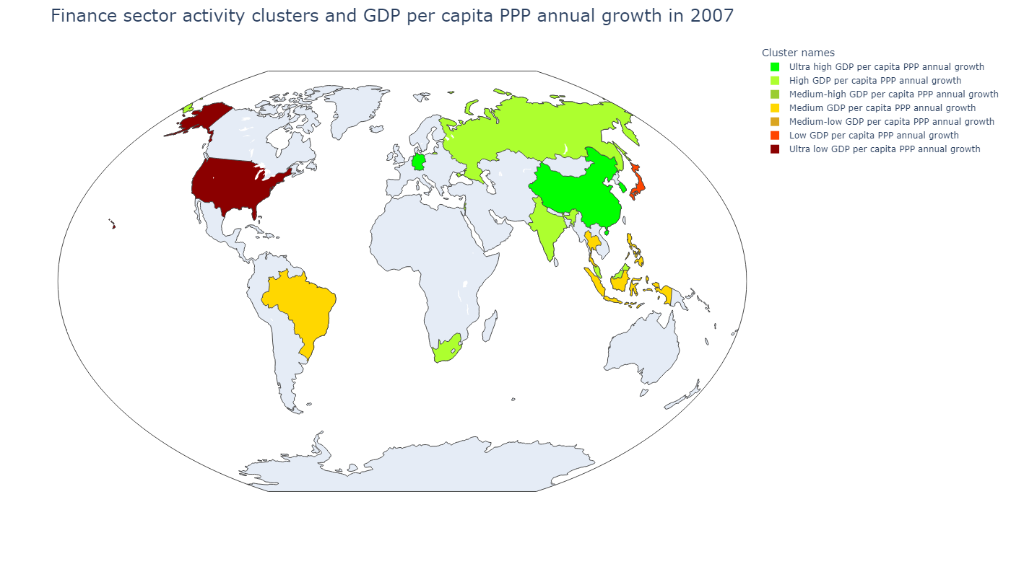
Country | Сluster names
Hong Kong SAR, China | Medium-high GDP per capita PPP annual growth
Israel | High GDP per capita PPP annual growth
Singapore | Medium-low GDP per capita PPP annual growth
Sum of squared distances to their centroid: | 55 219,51
Сluster names | GDP per capita, PPP (weighted annual growth rate %) | Stock price volatility | Value-traded ratio (%) | Stock market turnover ratio (%) | Market capitalization to GDP | Bank deposits to GDP (%) | Broad money (% of GDP) | Central bank assets to GDP (%) | Domestic credit to private sector (% of GDP)
Ultra high GDP per capita PPP annual growth | 8,78 | 45,43 | 35,63 | 269,95 | 13,20 | 26,13 | 105,96 | 3,12 | 89,46
High GDP per capita PPP annual growth | 6,25 | 34,25 | 24,53 | 123,56 | 19,75 | 33,71 | 36,46 | 2,92 | 37,35
Medium-high GDP per capita PPP annual growth | 5,47 | 18,22 | 1 419,65 | 4 534,76 | 31,31 | 35,08 | 44,69 | 9,75 | 23,40
Medium GDP per capita PPP annual growth | 4,15 | 18,00 | 64,76 | 22,69 | 292,41 | 134,14 | 144,98 | 24,67 | 149,15
Medium-low GDP per capita PPP annual growth | 2,90 | 15,81 | 24,15 | 39,38 | 61,33 | 192,28 | 201,45 | 5,84 | 193,50
Low GDP per capita PPP annual growth | 2,59 | 11,97 | 55,06 | 44,44 | 136,29 | 58,14 | 63,06 | 29,10 | 112,32
Сluster names | GDP per capita, PPP (weighted annual growth rate %) | Stock price volatility | Value-traded ratio (%) | Stock market turnover ratio (%) | Market capitalization to GDP | Bank deposits to GDP (%) | Broad money (% of GDP) | Central bank assets to GDP (%) | Domestic credit to private sector (% of GDP)
Ultra high GDP per capita PPP annual growth | 10,40 | 21,19 | 145,39 | 155,41 | 94,45 | 55,39 | 113,69 | 2,48 | 110,68
High GDP per capita PPP annual growth | 6,56 | 18,31 | 79,85 | 52,31 | 164,26 | 68,97 | 76,36 | 1,19 | 78,68
Medium-high GDP per capita PPP annual growth | 5,55 | 17,36 | 952,67 | 75,94 | 1 254,47 | 287,80 | 290,58 | 87,91 | 136,68
Medium GDP per capita PPP annual growth | 4,77 | 24,22 | 34,85 | 57,37 | 65,94 | 52,59 | 62,03 | 5,99 | 45,68
Medium-low GDP per capita PPP annual growth | 4,57 | 16,70 | 210,72 | 70,72 | 297,98 | 103,00 | 109,12 | 95,42 | 85,35
Low GDP per capita PPP annual growth | 1,37 | 18,39 | 143,80 | 152,07 | 94,57 | 178,91 | 192,52 | 13,32 | 160,17
Ultra low GDP per capita PPP annual growth | 1,04 | 11,51 | 296,06 | 215,10 | 137,64 | 74,33 | 79,48 | 5,12 | 206,35

Slide 13
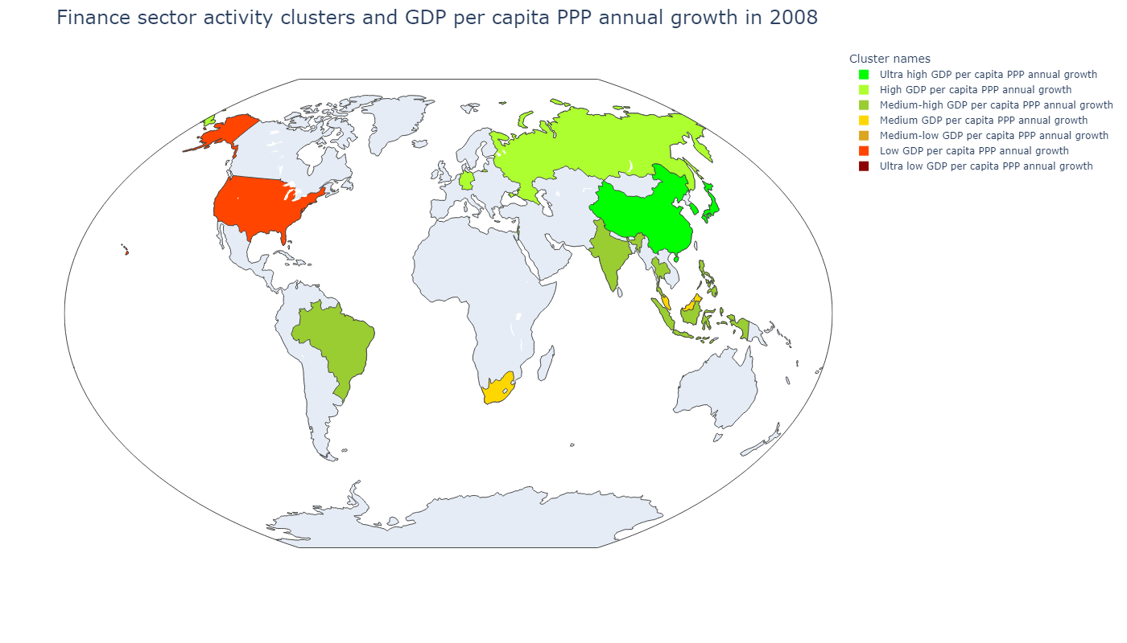
Country | Сluster names
Hong Kong SAR, China | Medium-low GDP per capita PPP annual growth
Israel | Medium-high GDP per capita PPP annual growth
Singapore | Ultra low GDP per capita PPP annual growth
Sum of squared distances to their centroid: | 64 869,07
Сluster names | GDP per capita, PPP (weighted annual growth rate %) | Stock price volatility | Value-traded ratio (%) | Stock market turnover ratio (%) | Market capitalization to GDP | Bank deposits to GDP (%) | Broad money (% of GDP) | Central bank assets to GDP (%) | Domestic credit to private sector (% of GDP)
Ultra high GDP per capita PPP annual growth | 8,78 | 45,43 | 35,63 | 269,95 | 13,20 | 26,13 | 105,96 | 3,12 | 89,46
High GDP per capita PPP annual growth | 6,25 | 34,25 | 24,53 | 123,56 | 19,75 | 33,71 | 36,46 | 2,92 | 37,35
Medium-high GDP per capita PPP annual growth | 5,47 | 18,22 | 1 419,65 | 4 534,76 | 31,31 | 35,08 | 44,69 | 9,75 | 23,40
Medium GDP per capita PPP annual growth | 4,15 | 18,00 | 64,76 | 22,69 | 292,41 | 134,14 | 144,98 | 24,67 | 149,15
Medium-low GDP per capita PPP annual growth | 2,90 | 15,81 | 24,15 | 39,38 | 61,33 | 192,28 | 201,45 | 5,84 | 193,50
Low GDP per capita PPP annual growth | 2,59 | 11,97 | 55,06 | 44,44 | 136,29 | 58,14 | 63,06 | 29,10 | 112,32
Сluster names | GDP per capita, PPP (weighted annual growth rate %) | Stock price volatility | Value-traded ratio (%) | Stock market turnover ratio (%) | Market capitalization to GDP | Bank deposits to GDP (%) | Broad money (% of GDP) | Central bank assets to GDP (%) | Domestic credit to private sector (% of GDP)
Ultra high GDP per capita PPP annual growth | 5,54 | 29,66 | 106,64 | 223,66 | 48,23 | 94,33 | 156,92 | 6,20 | 134,15
High GDP per capita PPP annual growth | 3,12 | 24,08 | 90,70 | 334,09 | 26,78 | 50,04 | 59,81 | 0,49 | 69,28
Medium-high GDP per capita PPP annual growth | 2,43 | 26,72 | 35,78 | 101,15 | 35,49 | 60,63 | 66,75 | 4,60 | 51,16
Medium GDP per capita PPP annual growth | 2,32 | 21,27 | 49,88 | 42,74 | 117,34 | 82,88 | 96,44 | 0,50 | 111,35
Medium-low GDP per capita PPP annual growth | 1,52 | 34,10 | 715,17 | 118,02 | 605,97 | 289,63 | 289,02 | 90,79 | 140,29
Low GDP per capita PPP annual growth | - 0,83 | 21,42 | 319,88 | 407,63 | 78,47 | 78,63 | 84,25 | 3,22 | 185,13
Ultra low GDP per capita PPP annual growth | - 3,42 | 25,26 | 130,68 | 95,49 | 136,85 | 114,77 | 121,71 | 100,22 | 97,86

Slide 14
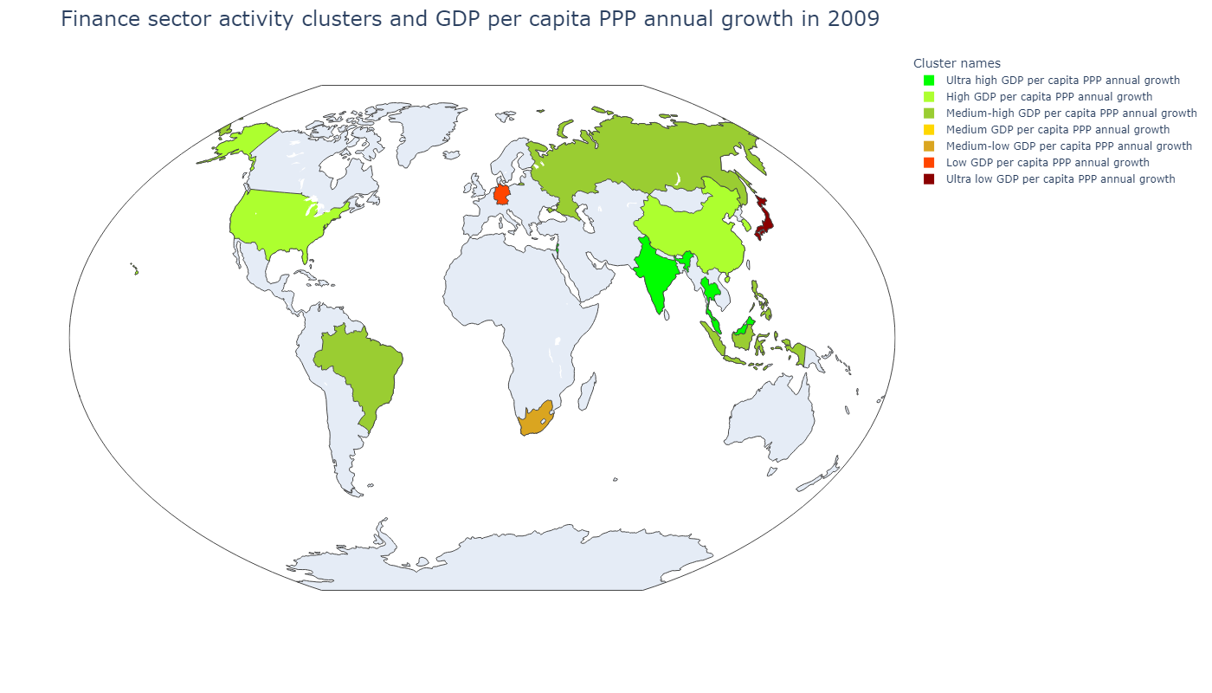
Country | Сluster names
Hong Kong SAR, China | Medium GDP per capita PPP annual growth
Israel | Ultra high GDP per capita PPP annual growth
Singapore | Medium-low GDP per capita PPP annual growth
Sum of squared distances to their centroid: | 45 589,67
Сluster names | GDP per capita, PPP (weighted annual growth rate %) | Stock price volatility | Value-traded ratio (%) | Stock market turnover ratio (%) | Market capitalization to GDP | Bank deposits to GDP (%) | Broad money (% of GDP) | Central bank assets to GDP (%) | Domestic credit to private sector (% of GDP)
Ultra high GDP per capita PPP annual growth | 8,78 | 45,43 | 35,63 | 269,95 | 13,20 | 26,13 | 105,96 | 3,12 | 89,46
High GDP per capita PPP annual growth | 6,25 | 34,25 | 24,53 | 123,56 | 19,75 | 33,71 | 36,46 | 2,92 | 37,35
Medium-high GDP per capita PPP annual growth | 5,47 | 18,22 | 1 419,65 | 4 534,76 | 31,31 | 35,08 | 44,69 | 9,75 | 23,40
Medium GDP per capita PPP annual growth | 4,15 | 18,00 | 64,76 | 22,69 | 292,41 | 134,14 | 144,98 | 24,67 | 149,15
Medium-low GDP per capita PPP annual growth | 2,90 | 15,81 | 24,15 | 39,38 | 61,33 | 192,28 | 201,45 | 5,84 | 193,50
Low GDP per capita PPP annual growth | 2,59 | 11,97 | 55,06 | 44,44 | 136,29 | 58,14 | 63,06 | 29,10 | 112,32
Сluster names | GDP per capita, PPP (weighted annual growth rate %) | Stock price volatility | Value-traded ratio (%) | Stock market turnover ratio (%) | Market capitalization to GDP | Bank deposits to GDP (%) | Broad money (% of GDP) | Central bank assets to GDP (%) | Domestic credit to private sector (% of GDP)
Ultra high GDP per capita PPP annual growth | 4,28 | 25,15 | 50,19 | 54,62 | 99,19 | 94,90 | 101,00 | 2,26 | 83,56
High GDP per capita PPP annual growth | 1,80 | 33,03 | 189,67 | 216,21 | 87,53 | 66,05 | 131,92 | 3,72 | 149,99
Medium-high GDP per capita PPP annual growth | - 2,36 | 34,34 | 27,07 | 44,14 | 57,86 | 42,83 | 55,75 | 7,08 | 37,08
Medium GDP per capita PPP annual growth | - 2,67 | 47,11 | 660,26 | 61,31 | 1 076,93 | 312,74 | 315,70 | 132,92 | 155,43
Medium-low GDP per capita PPP annual growth | - 2,75 | 34,06 | 98,35 | 39,98 | 245,09 | 89,23 | 100,58 | 53,01 | 108,98
Low GDP per capita PPP annual growth | - 5,64 | 38,02 | 50,29 | 136,66 | 36,78 | 61,75 | 66,56 | 0,64 | 67,93
Ultra low GDP per capita PPP annual growth | - 5,68 | 38,22 | 73,13 | 117,00 | 62,50 | 200,12 | 216,02 | 15,00 | 165,60

Slide 15
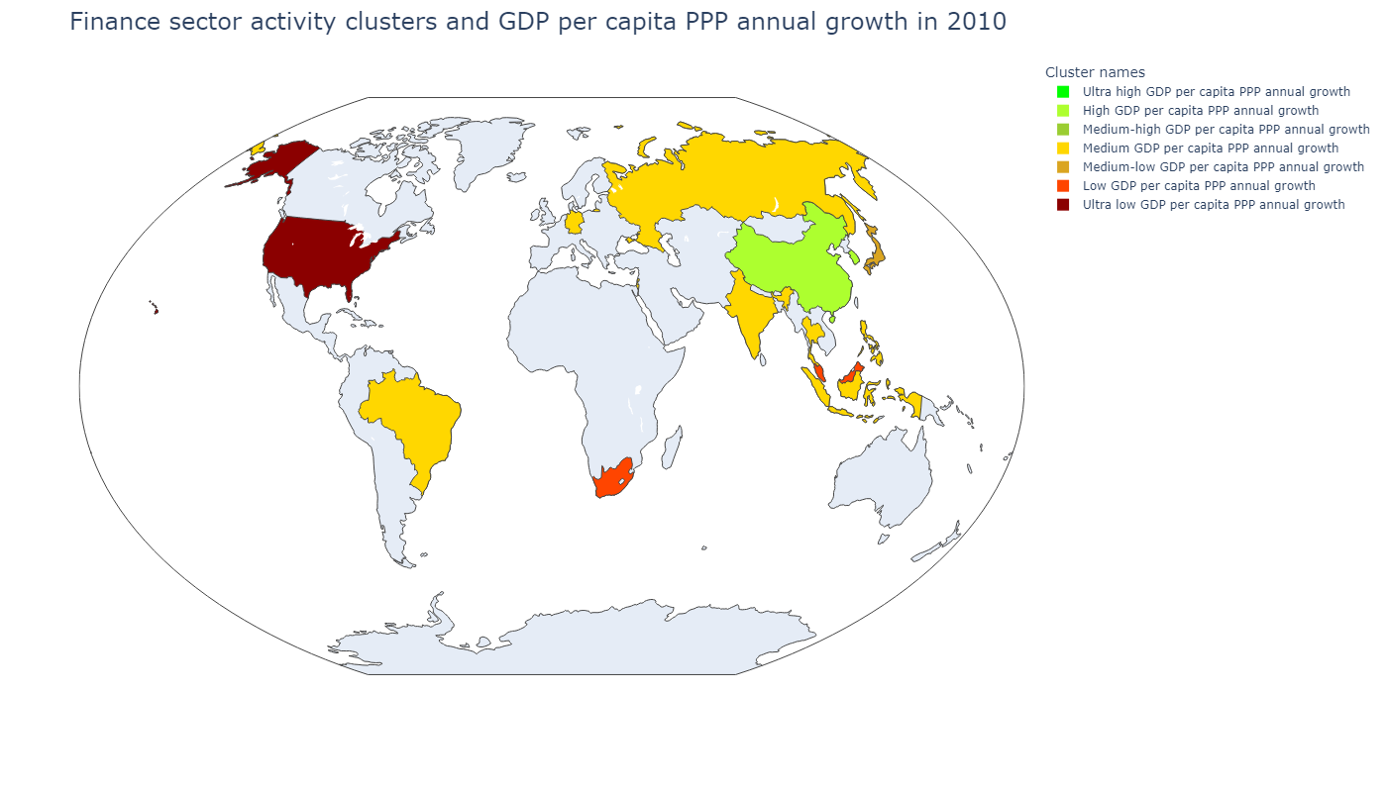
Country | Сluster names
Hong Kong SAR, China | Medium-high GDP per capita PPP annual growth
Israel | Medium GDP per capita PPP annual growth
Singapore | Ultra high GDP per capita PPP annual growth
Sum of squared distances to their centroid: | 42 199,35
Сluster names | GDP per capita, PPP (weighted annual growth rate %) | Stock price volatility | Value-traded ratio (%) | Stock market turnover ratio (%) | Market capitalization to GDP | Bank deposits to GDP (%) | Broad money (% of GDP) | Central bank assets to GDP (%) | Domestic credit to private sector (% of GDP)
Ultra high GDP per capita PPP annual growth | 8,78 | 45,43 | 35,63 | 269,95 | 13,20 | 26,13 | 105,96 | 3,12 | 89,46
High GDP per capita PPP annual growth | 6,25 | 34,25 | 24,53 | 123,56 | 19,75 | 33,71 | 36,46 | 2,92 | 37,35
Medium-high GDP per capita PPP annual growth | 5,47 | 18,22 | 1 419,65 | 4 534,76 | 31,31 | 35,08 | 44,69 | 9,75 | 23,40
Medium GDP per capita PPP annual growth | 4,15 | 18,00 | 64,76 | 22,69 | 292,41 | 134,14 | 144,98 | 24,67 | 149,15
Medium-low GDP per capita PPP annual growth | 2,90 | 15,81 | 24,15 | 39,38 | 61,33 | 192,28 | 201,45 | 5,84 | 193,50
Low GDP per capita PPP annual growth | 2,59 | 11,97 | 55,06 | 44,44 | 136,29 | 58,14 | 63,06 | 29,10 | 112,32
Сluster names | GDP per capita, PPP (weighted annual growth rate %) | Stock price volatility | Value-traded ratio (%) | Stock market turnover ratio (%) | Market capitalization to GDP | Bank deposits to GDP (%) | Broad money (% of GDP) | Central bank assets to GDP (%) | Domestic credit to private sector (% of GDP)
Ultra high GDP per capita PPP annual growth | 12,51 | 23,24 | 127,52 | 47,25 | 269,89 | 116,46 | 123,28 | 96,40 | 94,86
High GDP per capita PPP annual growth | 9,67 | 21,49 | 139,08 | 177,14 | 80,82 | 59,13 | 150,84 | 2,49 | 128,31
Medium-high GDP per capita PPP annual growth | 5,99 | 31,14 | 650,63 | 54,87 | 1 185,85 | 313,12 | 315,26 | 141,02 | 185,58
Medium GDP per capita PPP annual growth | 5,77 | 24,38 | 40,96 | 64,54 | 68,74 | 59,96 | 67,91 | 4,12 | 57,52
Medium-low GDP per capita PPP annual growth | 4,08 | 25,48 | 74,15 | 111,56 | 66,47 | 199,35 | 215,34 | 15,50 | 158,61
Low GDP per capita PPP annual growth | 3,56 | 18,00 | 55,72 | 29,03 | 190,95 | 86,62 | 98,91 | 0,36 | 115,61
Ultra low GDP per capita PPP annual growth | 1,85 | 26,42 | 239,39 | 208,44 | 114,85 | 78,64 | 84,85 | 6,79 | 181,92

Slide 16

Country | Сluster names
Hong Kong SAR, China | Medium-high GDP per capita PPP annual growth
Israel | Medium GDP per capita PPP annual growth
Singapore | Medium-low GDP per capita PPP annual growth
Sum of squared distances to their centroid: | 42 837,40
Сluster names | GDP per capita, PPP (weighted annual growth rate %) | Stock price volatility | Value-traded ratio (%) | Stock market turnover ratio (%) | Market capitalization to GDP | Bank deposits to GDP (%) | Broad money (% of GDP) | Central bank assets to GDP (%) | Domestic credit to private sector (% of GDP)
Ultra high GDP per capita PPP annual growth | 8,78 | 45,43 | 35,63 | 269,95 | 13,20 | 26,13 | 105,96 | 3,12 | 89,46
High GDP per capita PPP annual growth | 6,25 | 34,25 | 24,53 | 123,56 | 19,75 | 33,71 | 36,46 | 2,92 | 37,35
Medium-high GDP per capita PPP annual growth | 5,47 | 18,22 | 1 419,65 | 4 534,76 | 31,31 | 35,08 | 44,69 | 9,75 | 23,40
Medium GDP per capita PPP annual growth | 4,15 | 18,00 | 64,76 | 22,69 | 292,41 | 134,14 | 144,98 | 24,67 | 149,15
Medium-low GDP per capita PPP annual growth | 2,90 | 15,81 | 24,15 | 39,38 | 61,33 | 192,28 | 201,45 | 5,84 | 193,50
Low GDP per capita PPP annual growth | 2,59 | 11,97 | 55,06 | 44,44 | 136,29 | 58,14 | 63,06 | 29,10 | 112,32
Сluster names | GDP per capita, PPP (weighted annual growth rate %) | Stock price volatility | Value-traded ratio (%) | Stock market turnover ratio (%) | Market capitalization to GDP | Bank deposits to GDP (%) | Broad money (% of GDP) | Central bank assets to GDP (%) | Domestic credit to private sector (% of GDP)
Ultra high GDP per capita PPP annual growth | 8,32 | 16,89 | 121,36 | 194,89 | 62,33 | 57,75 | 150,31 | 2,16 | 127,82
High GDP per capita PPP annual growth | 6,98 | 22,18 | 42,51 | 158,03 | 27,54 | 60,78 | 64,49 | 0,46 | 66,98
Medium-high GDP per capita PPP annual growth | 4,11 | 19,63 | 578,22 | 63,64 | 908,62 | 315,41 | 323,84 | 136,80 | 202,29
Medium GDP per capita PPP annual growth | 3,82 | 19,05 | 25,24 | 48,30 | 54,42 | 54,62 | 62,23 | 5,40 | 46,56
Medium-low GDP per capita PPP annual growth | 2,04 | 15,00 | 62,35 | 46,91 | 147,89 | 99,09 | 111,96 | 24,27 | 115,69
Low GDP per capita PPP annual growth | 0,83 | 18,59 | 263,12 | 262,43 | 100,26 | 80,34 | 87,32 | 10,75 | 174,47
Ultra low GDP per capita PPP annual growth | 0,21 | 20,76 | 69,15 | 129,62 | 53,35 | 208,45 | 225,22 | 18,76 | 157,84

Slide 17
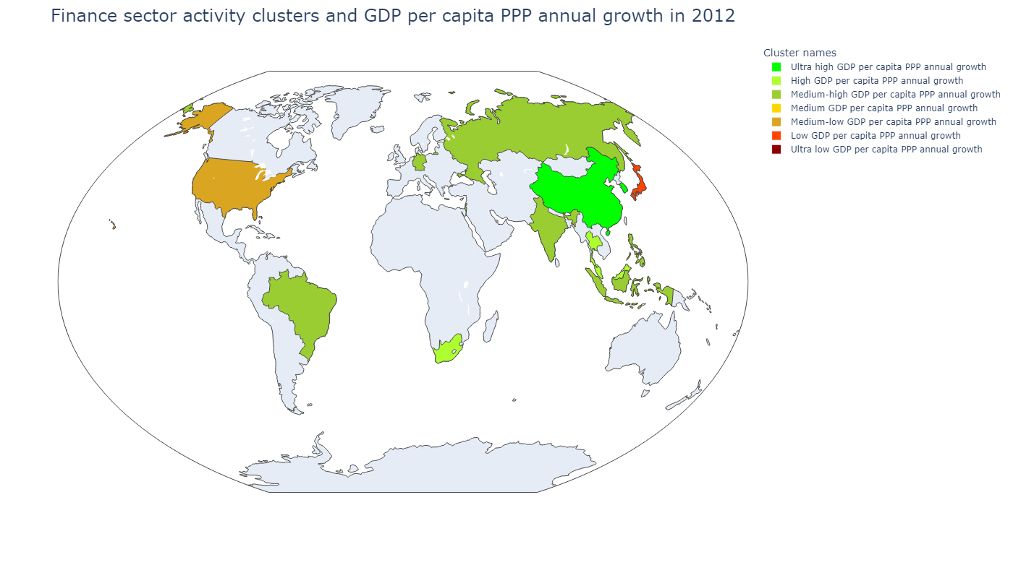
Country | Сluster names
Hong Kong SAR, China | Ultra low GDP per capita PPP annual growth
Israel | Medium-high GDP per capita PPP annual growth
Singapore | Medium GDP per capita PPP annual growth
Sum of squared distances to their centroid: | 35 794,98
Сluster names | GDP per capita, PPP (weighted annual growth rate %) | Stock price volatility | Value-traded ratio (%) | Stock market turnover ratio (%) | Market capitalization to GDP | Bank deposits to GDP (%) | Broad money (% of GDP) | Central bank assets to GDP (%) | Domestic credit to private sector (% of GDP)
Ultra high GDP per capita PPP annual growth | 8,78 | 45,43 | 35,63 | 269,95 | 13,20 | 26,13 | 105,96 | 3,12 | 89,46
High GDP per capita PPP annual growth | 6,25 | 34,25 | 24,53 | 123,56 | 19,75 | 33,71 | 36,46 | 2,92 | 37,35
Medium-high GDP per capita PPP annual growth | 5,47 | 18,22 | 1 419,65 | 4 534,76 | 31,31 | 35,08 | 44,69 | 9,75 | 23,40
Medium GDP per capita PPP annual growth | 4,15 | 18,00 | 64,76 | 22,69 | 292,41 | 134,14 | 144,98 | 24,67 | 149,15
Medium-low GDP per capita PPP annual growth | 2,90 | 15,81 | 24,15 | 39,38 | 61,33 | 192,28 | 201,45 | 5,84 | 193,50
Low GDP per capita PPP annual growth | 2,59 | 11,97 | 55,06 | 44,44 | 136,29 | 58,14 | 63,06 | 29,10 | 112,32
Сluster names | GDP per capita, PPP (weighted annual growth rate %) | Stock price volatility | Value-traded ratio (%) | Stock market turnover ratio (%) | Market capitalization to GDP | Bank deposits to GDP (%) | Broad money (% of GDP) | Central bank assets to GDP (%) | Domestic credit to private sector (% of GDP)
Ultra high GDP per capita PPP annual growth | 6,61 | 14,69 | 91,46 | 135,16 | 67,81 | 57,20 | 154,17 | 2,17 | 129,83
High GDP per capita PPP annual growth | 4,15 | 15,78 | 50,54 | 37,59 | 151,79 | 97,34 | 108,16 | 1,14 | 125,17
Medium-high GDP per capita PPP annual growth | 2,95 | 21,70 | 25,40 | 52,65 | 54,64 | 54,06 | 63,25 | 4,41 | 53,24
Medium GDP per capita PPP annual growth | 1,90 | 16,85 | 88,36 | 34,08 | 259,27 | 121,76 | 128,91 | 96,04 | 112,97
Medium-low GDP per capita PPP annual growth | 1,54 | 21,04 | 199,02 | 173,29 | 114,85 | 81,03 | 87,92 | 10,23 | 175,44
Low GDP per capita PPP annual growth | 1,54 | 19,79 | 53,35 | 96,19 | 55,46 | 211,65 | 228,80 | 22,93 | 158,24
Ultra low GDP per capita PPP annual growth | 0,58 | 23,91 | 409,98 | 38,02 | 1 078,31 | 322,24 | 336,25 | 142,50 | 198,53

Slide 18
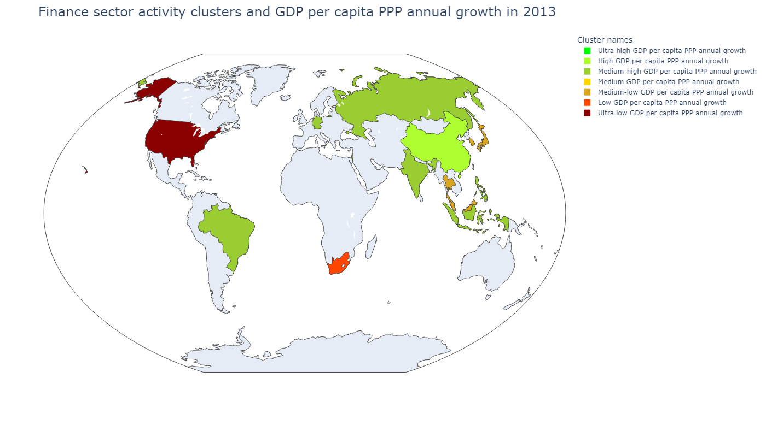
Country | Сluster names
Hong Kong SAR, China | Medium GDP per capita PPP annual growth
Israel | Medium-high GDP per capita PPP annual growth
Singapore | Low GDP per capita PPP annual growth
Sum of squared distances to their centroid: | 48 377,22
Сluster names | GDP per capita, PPP (weighted annual growth rate %) | Stock price volatility | Value-traded ratio (%) | Stock market turnover ratio (%) | Market capitalization to GDP | Bank deposits to GDP (%) | Broad money (% of GDP) | Central bank assets to GDP (%) | Domestic credit to private sector (% of GDP)
Ultra high GDP per capita PPP annual growth | 8,78 | 45,43 | 35,63 | 269,95 | 13,20 | 26,13 | 105,96 | 3,12 | 89,46
High GDP per capita PPP annual growth | 6,25 | 34,25 | 24,53 | 123,56 | 19,75 | 33,71 | 36,46 | 2,92 | 37,35
Medium-high GDP per capita PPP annual growth | 5,47 | 18,22 | 1 419,65 | 4 534,76 | 31,31 | 35,08 | 44,69 | 9,75 | 23,40
Medium GDP per capita PPP annual growth | 4,15 | 18,00 | 64,76 | 22,69 | 292,41 | 134,14 | 144,98 | 24,67 | 149,15
Medium-low GDP per capita PPP annual growth | 2,90 | 15,81 | 24,15 | 39,38 | 61,33 | 192,28 | 201,45 | 5,84 | 193,50
Low GDP per capita PPP annual growth | 2,59 | 11,97 | 55,06 | 44,44 | 136,29 | 58,14 | 63,06 | 29,10 | 112,32
Сluster names | GDP per capita, PPP (weighted annual growth rate %) | Stock price volatility | Value-traded ratio (%) | Stock market turnover ratio (%) | Market capitalization to GDP | Bank deposits to GDP (%) | Broad money (% of GDP) | Central bank assets to GDP (%) | Domestic credit to private sector (% of GDP)
Ultra high GDP per capita PPP annual growth | 7,10 | 22,36 | 39,07 | 191,19 | 20,44 | 47,20 | 52,19 | 0,67 | 60,25
High GDP per capita PPP annual growth | 7,05 | 18,24 | 80,41 | 194,88 | 41,26 | 47,00 | 186,61 | 2,59 | 134,32
Medium-high GDP per capita PPP annual growth | 2,93 | 18,18 | 21,61 | 41,76 | 53,96 | 57,94 | 67,78 | 4,64 | 54,59
Medium GDP per capita PPP annual growth | 2,69 | 18,00 | 459,56 | 40,86 | 1 124,71 | 335,90 | 353,92 | 140,96 | 218,16
Medium-low GDP per capita PPP annual growth | 2,32 | 14,54 | 85,24 | 92,19 | 104,08 | 144,61 | 156,37 | 9,70 | 138,07
Low GDP per capita PPP annual growth | 1,87 | 12,51 | 74,28 | 31,04 | 238,60 | 87,83 | 96,92 | 46,34 | 125,55
Ultra low GDP per capita PPP annual growth | 1,41 | 13,92 | 197,39 | 138,33 | 142,70 | 81,28 | 88,66 | 13,14 | 184,57

Slide 19
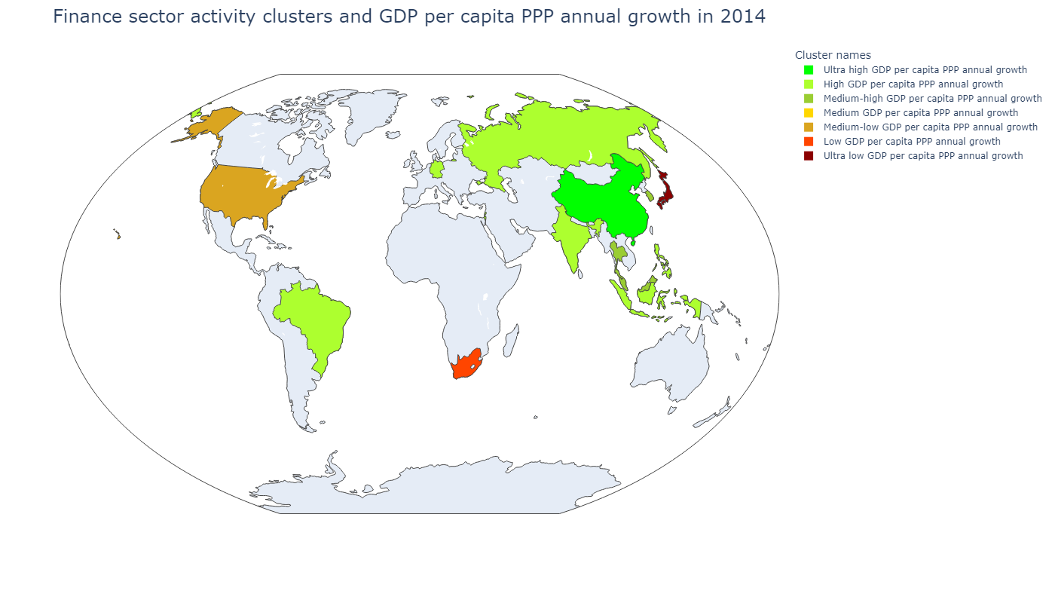
Country | Сluster names
Hong Kong SAR, China | Medium GDP per capita PPP annual growth
Israel | High GDP per capita PPP annual growth
Singapore | Low GDP per capita PPP annual growth
Sum of squared distances to their centroid: | 43 017,52
Сluster names | GDP per capita, PPP (weighted annual growth rate %) | Stock price volatility | Value-traded ratio (%) | Stock market turnover ratio (%) | Market capitalization to GDP | Bank deposits to GDP (%) | Broad money (% of GDP) | Central bank assets to GDP (%) | Domestic credit to private sector (% of GDP)
Ultra high GDP per capita PPP annual growth | 8,78 | 45,43 | 35,63 | 269,95 | 13,20 | 26,13 | 105,96 | 3,12 | 89,46
High GDP per capita PPP annual growth | 6,25 | 34,25 | 24,53 | 123,56 | 19,75 | 33,71 | 36,46 | 2,92 | 37,35
Medium-high GDP per capita PPP annual growth | 5,47 | 18,22 | 1 419,65 | 4 534,76 | 31,31 | 35,08 | 44,69 | 9,75 | 23,40
Medium GDP per capita PPP annual growth | 4,15 | 18,00 | 64,76 | 22,69 | 292,41 | 134,14 | 144,98 | 24,67 | 149,15
Medium-low GDP per capita PPP annual growth | 2,90 | 15,81 | 24,15 | 39,38 | 61,33 | 192,28 | 201,45 | 5,84 | 193,50
Low GDP per capita PPP annual growth | 2,59 | 11,97 | 55,06 | 44,44 | 136,29 | 58,14 | 63,06 | 29,10 | 112,32
Сluster names | GDP per capita, PPP (weighted annual growth rate %) | Stock price volatility | Value-traded ratio (%) | Stock market turnover ratio (%) | Market capitalization to GDP | Bank deposits to GDP (%) | Broad money (% of GDP) | Central bank assets to GDP (%) | Domestic credit to private sector (% of GDP)
Ultra high GDP per capita PPP annual growth | 6,75 | 17,32 | 114,16 | 199,16 | 57,32 | 44,72 | 190,87 | 2,38 | 140,24
High GDP per capita PPP annual growth | 2,74 | 18,34 | 22,85 | 58,17 | 50,39 | 57,78 | 67,60 | 3,98 | 56,83
Medium-high GDP per capita PPP annual growth | 2,30 | 13,43 | 68,31 | 69,70 | 107,71 | 121,87 | 132,35 | 1,15 | 132,57
Medium GDP per capita PPP annual growth | 2,04 | 15,22 | 497,82 | 44,88 | 1 109,25 | 346,75 | 363,37 | 142,44 | 233,21
Medium-low GDP per capita PPP annual growth | 1,77 | 11,29 | 222,08 | 148,03 | 150,03 | 81,91 | 89,49 | 14,05 | 185,40
Low GDP per capita PPP annual growth | 0,89 | 11,61 | 64,08 | 26,48 | 242,05 | 87,84 | 96,84 | 46,52 | 128,48
Ultra low GDP per capita PPP annual growth | 0,43 | 22,28 | 98,93 | 110,66 | 89,40 | 216,86 | 235,02 | 47,27 | 162,52

Slide 20
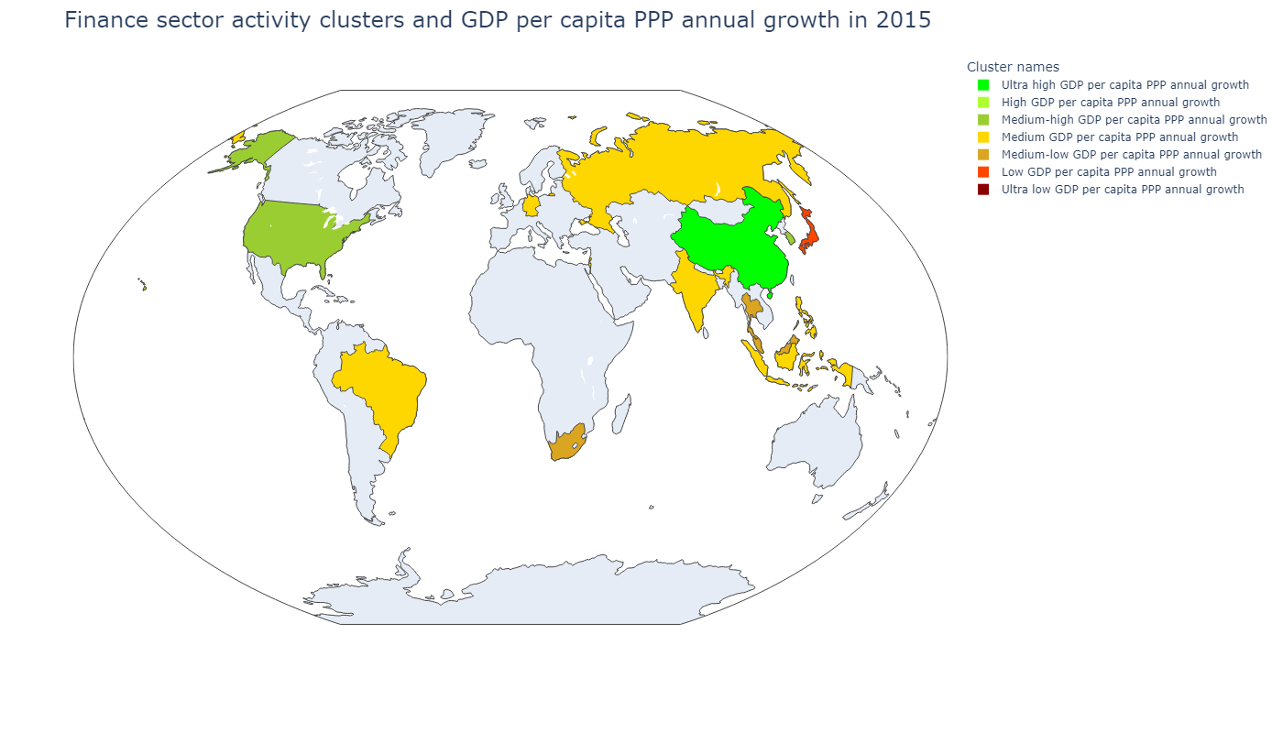
Country | Сluster names
Hong Kong SAR, China | Ultra low GDP per capita PPP annual growth
Israel | Medium GDP per capita PPP annual growth
Singapore | Medium-low GDP per capita PPP annual growth
Sum of squared distances to their centroid: | 50 473,90
Сluster names | GDP per capita, PPP (weighted annual growth rate %) | Stock price volatility | Value-traded ratio (%) | Stock market turnover ratio (%) | Market capitalization to GDP | Bank deposits to GDP (%) | Broad money (% of GDP) | Central bank assets to GDP (%) | Domestic credit to private sector (% of GDP)
Ultra high GDP per capita PPP annual growth | 8,78 | 45,43 | 35,63 | 269,95 | 13,20 | 26,13 | 105,96 | 3,12 | 89,46
High GDP per capita PPP annual growth | 6,25 | 34,25 | 24,53 | 123,56 | 19,75 | 33,71 | 36,46 | 2,92 | 37,35
Medium-high GDP per capita PPP annual growth | 5,47 | 18,22 | 1 419,65 | 4 534,76 | 31,31 | 35,08 | 44,69 | 9,75 | 23,40
Medium GDP per capita PPP annual growth | 4,15 | 18,00 | 64,76 | 22,69 | 292,41 | 134,14 | 144,98 | 24,67 | 149,15
Medium-low GDP per capita PPP annual growth | 2,90 | 15,81 | 24,15 | 39,38 | 61,33 | 192,28 | 201,45 | 5,84 | 193,50
Low GDP per capita PPP annual growth | 2,59 | 11,97 | 55,06 | 44,44 | 136,29 | 58,14 | 63,06 | 29,10 | 112,32
Сluster names | GDP per capita, PPP (weighted annual growth rate %) | Stock price volatility | Value-traded ratio (%) | Stock market turnover ratio (%) | Market capitalization to GDP | Bank deposits to GDP (%) | Broad money (% of GDP) | Central bank assets to GDP (%) | Domestic credit to private sector (% of GDP)
Ultra high GDP per capita PPP annual growth | 6,42 | 26,45 | 355,52 | 480,29 | 74,02 | 49,03 | 202,11 | 2,23 | 152,59
High GDP per capita PPP annual growth | 4,68 | 21,68 | 40,46 | 185,15 | 21,85 | 47,30 | 52,44 | 0,54 | 66,48
Medium-high GDP per capita PPP annual growth | 2,20 | 11,78 | 176,58 | 157,45 | 110,83 | 102,80 | 112,26 | 7,37 | 156,44
Medium GDP per capita PPP annual growth | 2,01 | 15,55 | 21,84 | 43,72 | 55,64 | 61,65 | 72,82 | 5,06 | 56,79
Medium-low GDP per capita PPP annual growth | 1,88 | 11,63 | 59,10 | 42,41 | 158,51 | 103,29 | 112,68 | 22,45 | 130,53
Low GDP per capita PPP annual growth | 1,67 | 18,28 | 125,35 | 113,82 | 110,12 | 214,48 | 233,41 | 57,84 | 161,78
Ultra low GDP per capita PPP annual growth | 1,52 | 16,21 | 668,64 | 64,95 | 1 029,42 | 348,33 | 365,59 | 147,08 | 207,90

Slide 21
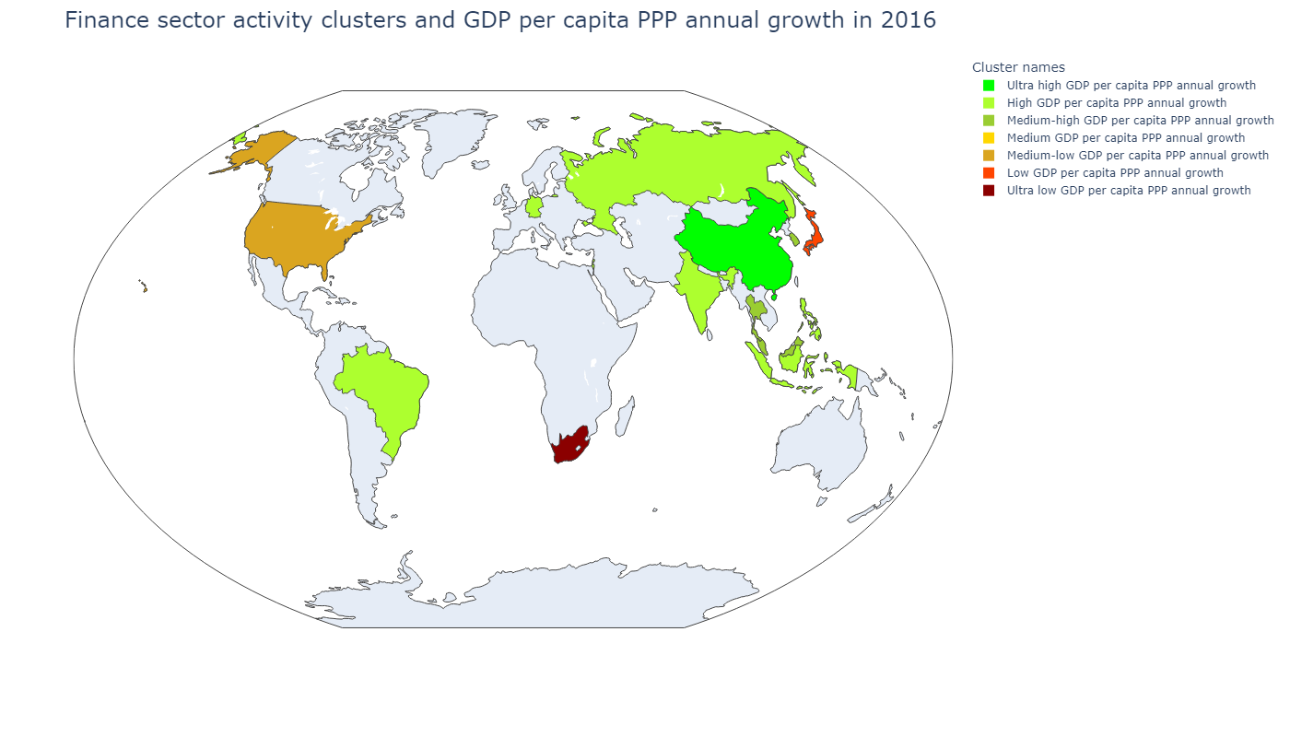
Country | Сluster names
Hong Kong SAR, China | Medium GDP per capita PPP annual growth
Israel | High GDP per capita PPP annual growth
Singapore | Medium-high GDP per capita PPP annual growth
Sum of squared distances to their centroid: | 50 163,96
Сluster names | GDP per capita, PPP (weighted annual growth rate %) | Stock price volatility | Value-traded ratio (%) | Stock market turnover ratio (%) | Market capitalization to GDP | Bank deposits to GDP (%) | Broad money (% of GDP) | Central bank assets to GDP (%) | Domestic credit to private sector (% of GDP)
Ultra high GDP per capita PPP annual growth | 8,78 | 45,43 | 35,63 | 269,95 | 13,20 | 26,13 | 105,96 | 3,12 | 89,46
High GDP per capita PPP annual growth | 6,25 | 34,25 | 24,53 | 123,56 | 19,75 | 33,71 | 36,46 | 2,92 | 37,35
Medium-high GDP per capita PPP annual growth | 5,47 | 18,22 | 1 419,65 | 4 534,76 | 31,31 | 35,08 | 44,69 | 9,75 | 23,40
Medium GDP per capita PPP annual growth | 4,15 | 18,00 | 64,76 | 22,69 | 292,41 | 134,14 | 144,98 | 24,67 | 149,15
Medium-low GDP per capita PPP annual growth | 2,90 | 15,81 | 24,15 | 39,38 | 61,33 | 192,28 | 201,45 | 5,84 | 193,50
Low GDP per capita PPP annual growth | 2,59 | 11,97 | 55,06 | 44,44 | 136,29 | 58,14 | 63,06 | 29,10 | 112,32
Сluster names | GDP per capita, PPP (weighted annual growth rate %) | Stock price volatility | Value-traded ratio (%) | Stock market turnover ratio (%) | Market capitalization to GDP | Bank deposits to GDP (%) | Broad money (% of GDP) | Central bank assets to GDP (%) | Domestic credit to private sector (% of GDP)
Ultra high GDP per capita PPP annual growth | 6,24 | 36,42 | 162,86 | 249,91 | 65,17 | 56,04 | 207,67 | 2,06 | 156,23
High GDP per capita PPP annual growth | 2,77 | 17,91 | 22,41 | 54,08 | 52,95 | 61,76 | 71,42 | 5,58 | 57,27
Medium-high GDP per capita PPP annual growth | 2,69 | 12,69 | 69,23 | 64,84 | 127,14 | 120,08 | 129,95 | 22,50 | 131,69
Medium GDP per capita PPP annual growth | 1,54 | 21,44 | 421,09 | 42,31 | 995,21 | 360,88 | 375,04 | 151,62 | 214,30
Medium-low GDP per capita PPP annual growth | 1,08 | 15,72 | 225,04 | 153,81 | 146,31 | 82,07 | 89,99 | 13,21 | 183,64
Low GDP per capita PPP annual growth | 0,81 | 24,90 | 104,53 | 105,55 | 99,03 | 218,60 | 239,59 | 71,62 | 162,35
Ultra low GDP per capita PPP annual growth | - 0,31 | 17,94 | 124,37 | 42,30 | 293,99 | 54,54 | 66,31 | 1,39 | 124,36

Slide 22
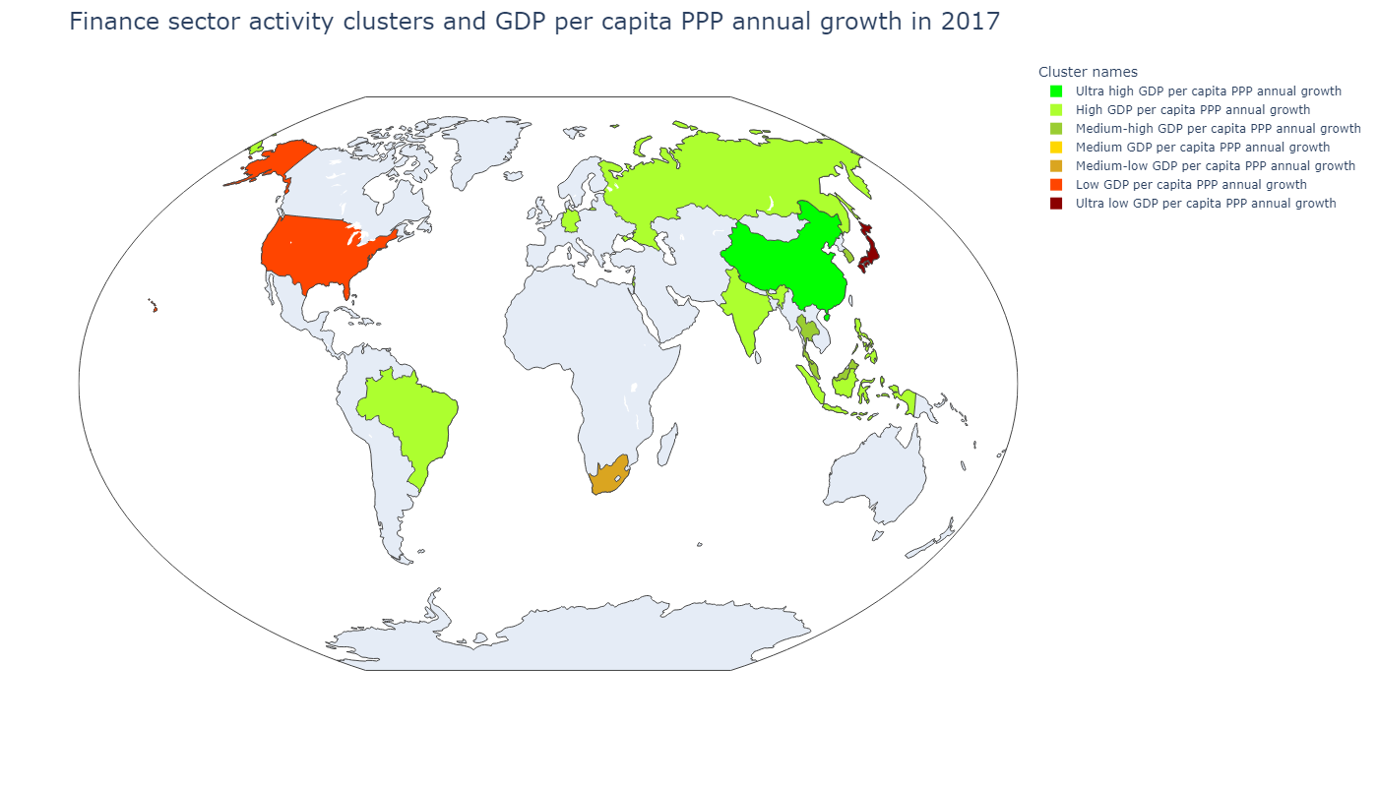
Country | Сluster names
Hong Kong SAR, China | Medium GDP per capita PPP annual growth
Israel | High GDP per capita PPP annual growth
Singapore | Medium-low GDP per capita PPP annual growth
Sum of squared distances to their centroid: | 49 854,17
Сluster names | GDP per capita, PPP (weighted annual growth rate %) | Stock price volatility | Value-traded ratio (%) | Stock market turnover ratio (%) | Market capitalization to GDP | Bank deposits to GDP (%) | Broad money (% of GDP) | Central bank assets to GDP (%) | Domestic credit to private sector (% of GDP)
Ultra high GDP per capita PPP annual growth | 8,78 | 45,43 | 35,63 | 269,95 | 13,20 | 26,13 | 105,96 | 3,12 | 89,46
High GDP per capita PPP annual growth | 6,25 | 34,25 | 24,53 | 123,56 | 19,75 | 33,71 | 36,46 | 2,92 | 37,35
Medium-high GDP per capita PPP annual growth | 5,47 | 18,22 | 1 419,65 | 4 534,76 | 31,31 | 35,08 | 44,69 | 9,75 | 23,40
Medium GDP per capita PPP annual growth | 4,15 | 18,00 | 64,76 | 22,69 | 292,41 | 134,14 | 144,98 | 24,67 | 149,15
Medium-low GDP per capita PPP annual growth | 2,90 | 15,81 | 24,15 | 39,38 | 61,33 | 192,28 | 201,45 | 5,84 | 193,50
Low GDP per capita PPP annual growth | 2,59 | 11,97 | 55,06 | 44,44 | 136,29 | 58,14 | 63,06 | 29,10 | 112,32
Сluster names | GDP per capita, PPP (weighted annual growth rate %) | Stock price volatility | Value-traded ratio (%) | Stock market turnover ratio (%) | Market capitalization to GDP | Bank deposits to GDP (%) | Broad money (% of GDP) | Central bank assets to GDP (%) | Domestic credit to private sector (% of GDP)
Ultra high GDP per capita PPP annual growth | 6,30 | 17,76 | 139,91 | 197,71 | 70,76 | 56,87 | 201,41 | 1,85 | 154,90
High GDP per capita PPP annual growth | 3,66 | 15,51 | 26,33 | 53,97 | 59,28 | 61,45 | 71,24 | 5,89 | 57,18
Medium-high GDP per capita PPP annual growth | 3,42 | 10,92 | 80,47 | 68,52 | 124,08 | 117,53 | 128,14 | 1,23 | 132,77
Medium GDP per capita PPP annual growth | 3,00 | 15,96 | 572,31 | 44,89 | 1 274,79 | 371,03 | 396,15 | 157,66 | 223,37
Medium-low GDP per capita PPP annual growth | 2,24 | 13,32 | 85,69 | 30,59 | 276,02 | 83,90 | 94,26 | 43,42 | 124,00
Low GDP per capita PPP annual growth | 1,81 | 11,01 | 204,27 | 123,86 | 164,91 | 82,22 | 90,52 | 12,63 | 191,63
Ultra low GDP per capita PPP annual growth | 1,76 | 21,03 | 117,19 | 92,86 | 126,20 | 221,34 | 244,02 | 74,67 | 167,63

Slide 23
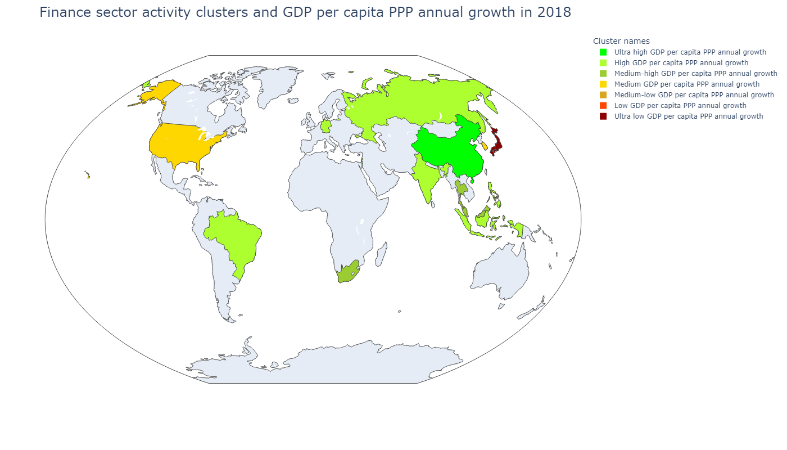
Country | Сluster names
Hong Kong SAR, China | Medium-low GDP per capita PPP annual growth
Israel | High GDP per capita PPP annual growth
Singapore | Medium-high GDP per capita PPP annual growth
Sum of squared distances to their centroid: | 47 095,97
Сluster names | GDP per capita, PPP (weighted annual growth rate %) | Stock price volatility | Value-traded ratio (%) | Stock market turnover ratio (%) | Market capitalization to GDP | Bank deposits to GDP (%) | Broad money (% of GDP) | Central bank assets to GDP (%) | Domestic credit to private sector (% of GDP)
Ultra high GDP per capita PPP annual growth | 8,78 | 45,43 | 35,63 | 269,95 | 13,20 | 26,13 | 105,96 | 3,12 | 89,46
High GDP per capita PPP annual growth | 6,25 | 34,25 | 24,53 | 123,56 | 19,75 | 33,71 | 36,46 | 2,92 | 37,35
Medium-high GDP per capita PPP annual growth | 5,47 | 18,22 | 1 419,65 | 4 534,76 | 31,31 | 35,08 | 44,69 | 9,75 | 23,40
Medium GDP per capita PPP annual growth | 4,15 | 18,00 | 64,76 | 22,69 | 292,41 | 134,14 | 144,98 | 24,67 | 149,15
Medium-low GDP per capita PPP annual growth | 2,90 | 15,81 | 24,15 | 39,38 | 61,33 | 192,28 | 201,45 | 5,84 | 193,50
Low GDP per capita PPP annual growth | 2,59 | 11,97 | 55,06 | 44,44 | 136,29 | 58,14 | 63,06 | 29,10 | 112,32
Сluster names | GDP per capita, PPP (weighted annual growth rate %) | Stock price volatility | Value-traded ratio (%) | Stock market turnover ratio (%) | Market capitalization to GDP | Bank deposits to GDP (%) | Broad money (% of GDP) | Central bank assets to GDP (%) | Domestic credit to private sector (% of GDP)
Ultra high GDP per capita PPP annual growth | 6,25 | 13,10 | 94,07 | 206,65 | 45,52 | 52,05 | 195,04 | 1,66 | 157,81
High GDP per capita PPP annual growth | 3,29 | 13,60 | 24,71 | 46,45 | 54,59 | 62,83 | 73,53 | 6,80 | 55,97
Medium-high GDP per capita PPP annual growth | 2,83 | 10,17 | 61,26 | 44,31 | 151,41 | 98,19 | 108,15 | 20,27 | 125,13
Medium GDP per capita PPP annual growth | 2,43 | 12,51 | 190,64 | 167,45 | 115,08 | 105,55 | 115,80 | 5,99 | 160,81
Medium-low GDP per capita PPP annual growth | 2,03 | 15,15 | 626,64 | 59,35 | 1 055,82 | 353,06 | 386,10 | 147,48 | 219,91
Low GDP per capita PPP annual growth | 1,63 | 18,32 | 47,47 | 247,76 | 19,16 | 48,98 | 53,12 | 0,54 | 67,50
Ultra low GDP per capita PPP annual growth | 0,77 | 13,44 | 125,06 | 119,02 | 105,08 | 224,34 | 248,13 | 78,19 | 167,35

Slide 24
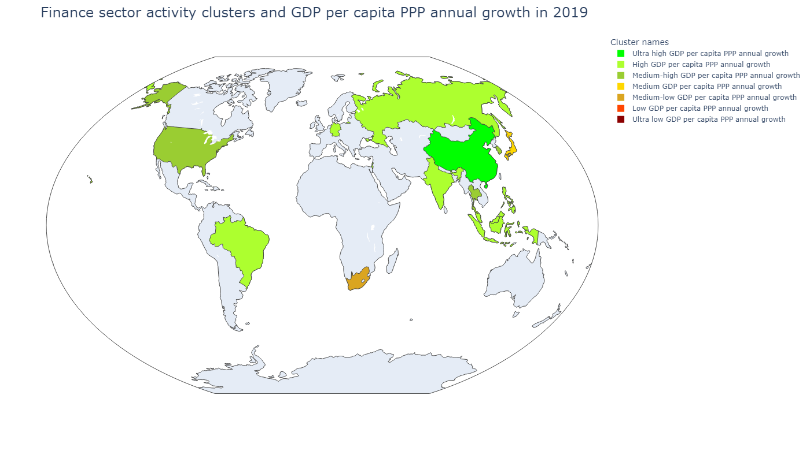
Country | Сluster names
Hong Kong SAR, China | Ultra low GDP per capita PPP annual growth
Israel | High GDP per capita PPP annual growth
Singapore | Medium-low GDP per capita PPP annual growth
Sum of squared distances to their centroid: | 50 930,48
Сluster names | GDP per capita, PPP (weighted annual growth rate %) | Stock price volatility | Value-traded ratio (%) | Stock market turnover ratio (%) | Market capitalization to GDP | Bank deposits to GDP (%) | Broad money (% of GDP) | Central bank assets to GDP (%) | Domestic credit to private sector (% of GDP)
Ultra high GDP per capita PPP annual growth | 8,78 | 45,43 | 35,63 | 269,95 | 13,20 | 26,13 | 105,96 | 3,12 | 89,46
High GDP per capita PPP annual growth | 6,25 | 34,25 | 24,53 | 123,56 | 19,75 | 33,71 | 36,46 | 2,92 | 37,35
Medium-high GDP per capita PPP annual growth | 5,47 | 18,22 | 1 419,65 | 4 534,76 | 31,31 | 35,08 | 44,69 | 9,75 | 23,40
Medium GDP per capita PPP annual growth | 4,15 | 18,00 | 64,76 | 22,69 | 292,41 | 134,14 | 144,98 | 24,67 | 149,15
Medium-low GDP per capita PPP annual growth | 2,90 | 15,81 | 24,15 | 39,38 | 61,33 | 192,28 | 201,45 | 5,84 | 193,50
Low GDP per capita PPP annual growth | 2,59 | 11,97 | 55,06 | 44,44 | 136,29 | 58,14 | 63,06 | 29,10 | 112,32
Сluster names | GDP per capita, PPP (weighted annual growth rate %) | Stock price volatility | Value-traded ratio (%) | Stock market turnover ratio (%) | Market capitalization to GDP | Bank deposits to GDP (%) | Broad money (% of GDP) | Central bank assets to GDP (%) | Domestic credit to private sector (% of GDP)
Ultra high GDP per capita PPP annual growth | 5,58 | 19,95 | 127,80 | 212,96 | 60,01 | 50,56 | 197,89 | 1,55 | 165,39
High GDP per capita PPP annual growth | 2,29 | 15,84 | 26,47 | 40,08 | 66,77 | 70,35 | 80,87 | 6,03 | 64,59
Medium-high GDP per capita PPP annual growth | 1,98 | 15,85 | 118,07 | 100,32 | 117,99 | 112,83 | 122,59 | 4,73 | 161,96
Medium GDP per capita PPP annual growth | - 0,26 | 16,53 | 99,60 | 82,34 | 120,97 | 228,38 | 252,71 | 81,42 | 175,36
Medium-low GDP per capita PPP annual growth | - 0,53 | 14,10 | 62,74 | 27,62 | 228,18 | 84,27 | 94,98 | 49,41 | 118,22
Low GDP per capita PPP annual growth | - 0,61 | 22,34 | 45,68 | 187,94 | 24,31 | 54,49 | 58,77 | 0,61 | 65,51
Ultra low GDP per capita PPP annual growth | - 2,40 | 18,33 | 501,89 | 37,19 | 1 349,37 | 370,49 | 403,31 | 147,42 | 236,74

Slide 25
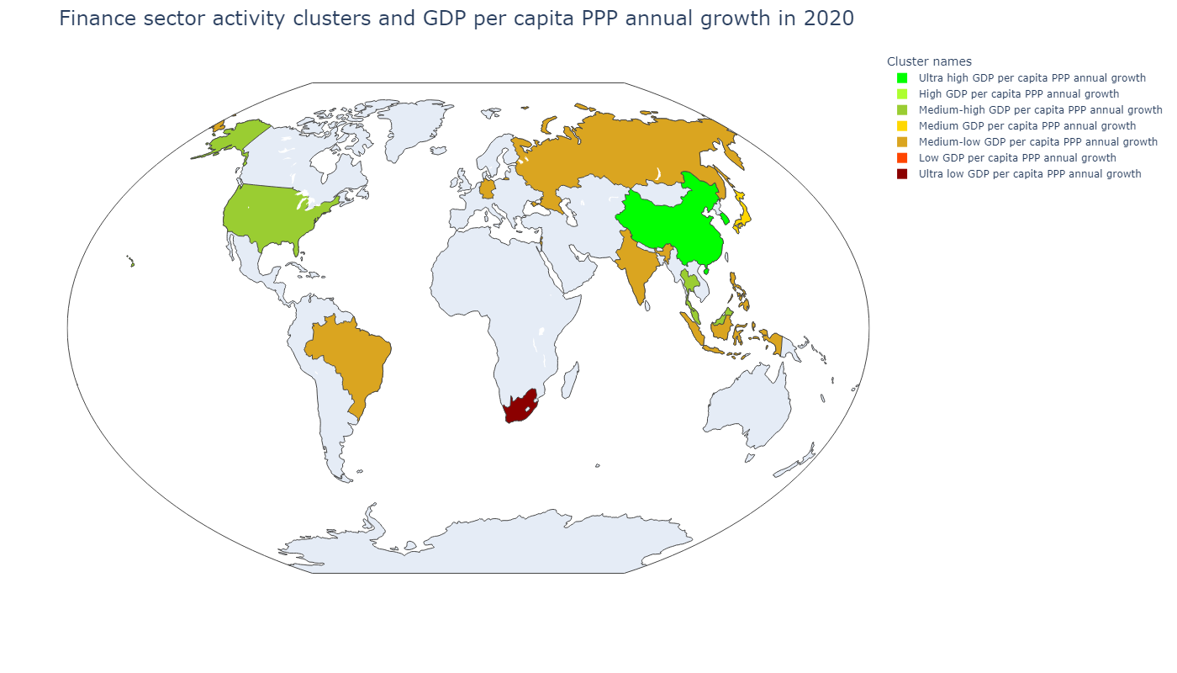
Country | Сluster names
Hong Kong SAR, China | Low GDP per capita PPP annual growth
Israel | Medium-low GDP per capita PPP annual growth
Singapore | Medium-high GDP per capita PPP annual growth
Sum of squared distances to their centroid: | 73 528,72
Сluster names | GDP per capita, PPP (weighted annual growth rate %) | Stock price volatility | Value-traded ratio (%) | Stock market turnover ratio (%) | Market capitalization to GDP | Bank deposits to GDP (%) | Broad money (% of GDP) | Central bank assets to GDP (%) | Domestic credit to private sector (% of GDP)
Ultra high GDP per capita PPP annual growth | 8,78 | 45,43 | 35,63 | 269,95 | 13,20 | 26,13 | 105,96 | 3,12 | 89,46
High GDP per capita PPP annual growth | 6,25 | 34,25 | 24,53 | 123,56 | 19,75 | 33,71 | 36,46 | 2,92 | 37,35
Medium-high GDP per capita PPP annual growth | 5,47 | 18,22 | 1 419,65 | 4 534,76 | 31,31 | 35,08 | 44,69 | 9,75 | 23,40
Medium GDP per capita PPP annual growth | 4,15 | 18,00 | 64,76 | 22,69 | 292,41 | 134,14 | 144,98 | 24,67 | 149,15
Medium-low GDP per capita PPP annual growth | 2,90 | 15,81 | 24,15 | 39,38 | 61,33 | 192,28 | 201,45 | 5,84 | 193,50
Low GDP per capita PPP annual growth | 2,59 | 11,97 | 55,06 | 44,44 | 136,29 | 58,14 | 63,06 | 29,10 | 112,32
Сluster names | GDP per capita, PPP (weighted annual growth rate %) | Stock price volatility | Value-traded ratio (%) | Stock market turnover ratio (%) | Market capitalization to GDP | Bank deposits to GDP (%) | Broad money (% of GDP) | Central bank assets to GDP (%) | Domestic credit to private sector (% of GDP)
Ultra high GDP per capita PPP annual growth | 1,75 | 22,78 | 265,35 | 247,89 | 107,97 | 102,99 | 188,38 | 1,54 | 173,50
High GDP per capita PPP annual growth | 0,88 | 24,24 | 120,58 | 365,77 | 32,97 | 63,15 | 67,48 | 1,96 | 75,15
Medium-high GDP per capita PPP annual growth | - 3,46 | 20,13 | 110,68 | 71,48 | 155,65 | 125,93 | 135,82 | 36,82 | 159,80
Medium GDP per capita PPP annual growth | - 3,86 | 19,31 | 125,35 | 94,33 | 132,89 | 254,15 | 280,37 | 92,24 | 193,49
Medium-low GDP per capita PPP annual growth | - 4,76 | 23,94 | 39,77 | 58,93 | 65,01 | 74,12 | 86,98 | 9,92 | 60,87
Low GDP per capita PPP annual growth | - 6,21 | 20,62 | 889,82 | 50,07 | 1 777,23 | 415,75 | 454,70 | 169,48 | 258,90
Ultra low GDP per capita PPP annual growth | - 7,11 | 23,45 | 86,86 | 27,94 | 310,84 | 63,21 | 73,97 | 1,12 | 108,95

